Slide 1
Psalms
Lesson 2
Teach Us to Pray

Slide 2
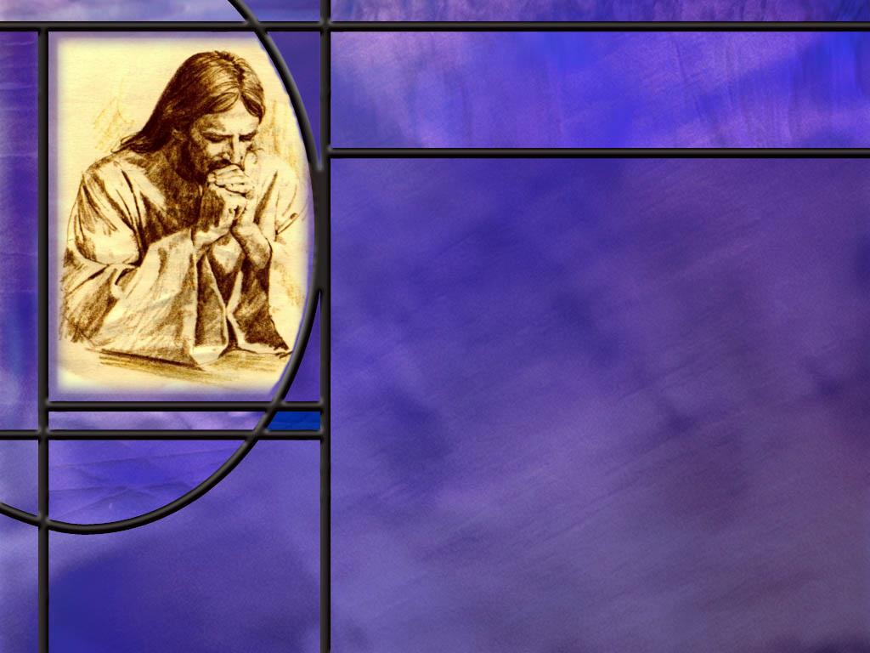
Memory Text
Luke 11:1 NKJV
Now it came to pass, as He was praying in a certain place, when He ceased, that one of His disciples said to Him, "Lord, teach us to pray, as John also taught his disciples.“
How did Jesus respond to this request?
Which gospels record the Lord’s Prayer?
Do you think Jesus was giving His disciples the exact words they should pray or was He instructing them on the subjects they should pray about?
What do the Psalms have to do with prayer?
Notes:
B2:
1. His response was to give His disciples what we call “the Lord’s prayer.”
B3:
1. Both Matthew and Luke record the Lord’s Prayer.
2. In Matthew it is part of the Sermon on the Mount.
3. It is found in Matthew 6:9-13
4. In Luke it comes after a visit to Martha and Mary and Lazarus’ home in Bethany, and is in response to a request of one of His disciples that saw Him praying.
5. The exact words used in the prayer are slightly different in these two gospels and some manuscripts include things that others leave out.
6. How many remember saying the Lord’s prayer in school before the start of classes?
7. Even in the public grade school that I attended, the teacher would read from the Bible, we would all stand and recite the Lord’s prayer, and pledge allegiance to the Flag.
8. Our version of the Lord’s prayer was kind of a compromise between Matthew and Luke.
9. Instead of saying “forgive us our debts as we forgive our debtors” as in Matthew’s version, we would say “forgive us our trespasses as we forgive those who trespass against us” as in Luke’s version.
10. And then at the end we would recite Matthew’s closing: “for Thine is the kingdom, and the power, and the glory forever, Amen.” which is not included in Luke’s version.
11. Generally speaking, Protestants use Matthew’s version and Catholics use Luke’s version.
12. But when you sing the Lord’s Prayer, you have to use Matthew’s version to get that wonderful climax at the end.
B4:
1. I don’t believe that Jesus ever intended His disciples to be limited to the few exact words of the Lord’s prayer.
2. It is more likely that He intended to give them an outline of the kinds of subjects they should pray about.
3. Within this outline, they could expand upon each theme in the way that would open their hearts to God.
4. For example, the prayer begins with “Our Father which art in heaven, Hallowed by thy name.”
5. This is obviously an invitation to lift up the Name of our God and praise Him for His goodness, His love, His grace, His compassion, and His forgiveness; to praise Him as our Creator, our Redeemer, our Sustainer, and our Restorer.
6. Under this outline heading we could go on and on in Praising God for who He is and what He has done and what He promises to do.
7. I don’t think it is wrong to repeat the Lord’s prayer verbatim, but how much better to use it as an outline to open our hearts to Him in our daily devotions.
8. Jesus spent hours in prayer, and He wasn’t repeating the same words over and over.
9. In fact before giving the Lord’s prayer in Matthew’s account, He said this.
Matthew 6:7 KJV - But when ye pray, use not vain repetitions, as the heathen do: for they think that they shall be heard for their much speaking.
10. Roman Catholics who pray the Rosary ought to go back and read these instructions from our Lord again.
B5:
1. The Psalms are the prayer book of the Bible.
2. These are inspired prayers that are recorded and included in the Bible to show us how God’s people prayed in ancient times and to teach us how we can pray today.
3. Our challenge this quarter is to use the book of Psalms to inform and enrich our own prayer life and draw us into a deeper relationship with God.

Slide 3
Overview
The NT epistles of Paul call us to make use of the Psalms in our worship and fellowship. These inspired prayers from ancient Israel, though often expressing complaint and despair, always seem to end with the recognition that God is in control and will be the ultimate solution for every difficulty.
  Encouragement to Sing Psalms
  Psalms from Darkness to Light
  Summary

Slide 4
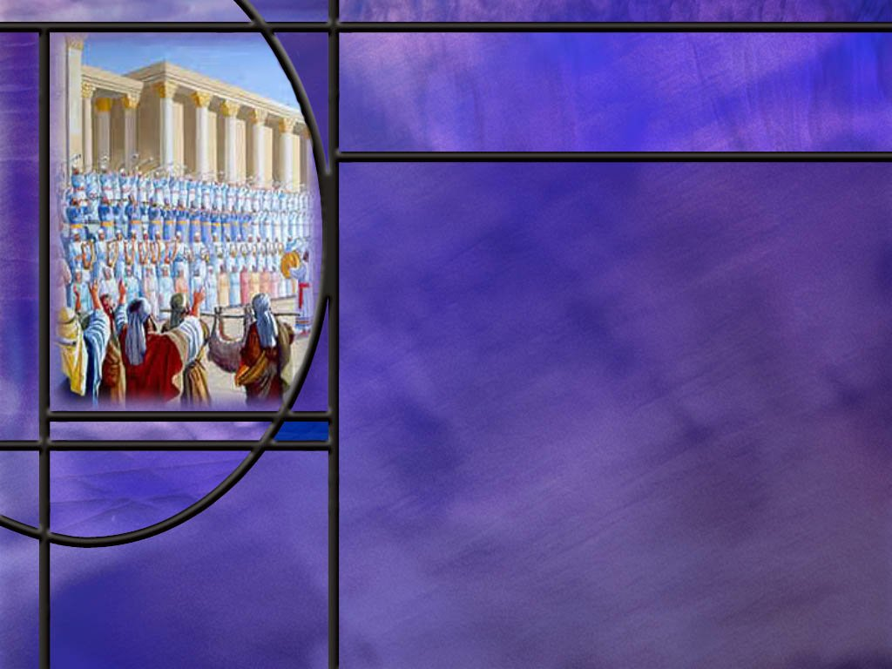
Encouragement to Sing Psalms
How does the apostle Paul encourage the Ephesian believers to express the fulness of the Spirit? (Eph 5:18-19)
What similar encouragement does Paul give to the Colossians? (Col 3:16)
How does James encourage his readers to use the Psalms? (James 5:13)
Notes:
B1:
[See notes on linked slide.]
B2:
[See notes on linked slide.]
B3:
[See notes on linked slide.]

Slide 5
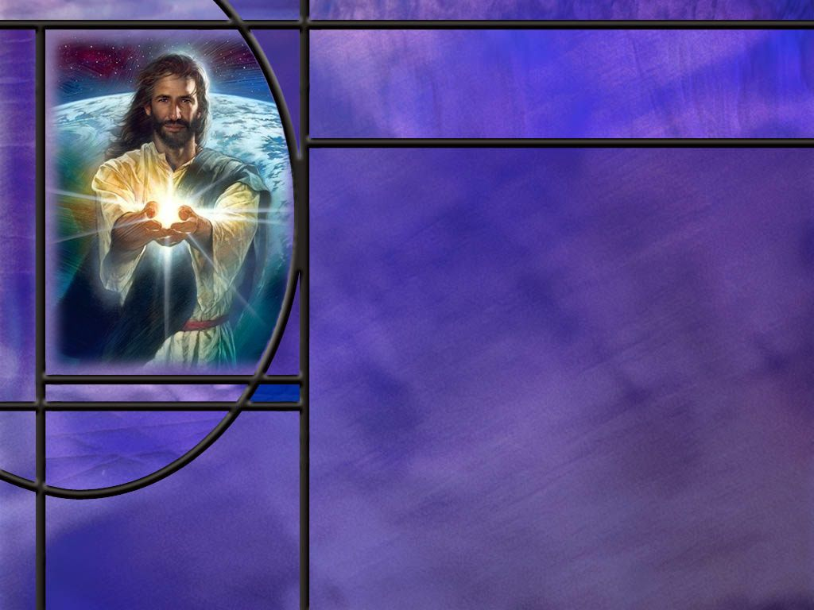
Psalms from Darkness to Light
How do the following Psalms begin in the darkness of despair yet transition to the light of hope in the goodness of God?
  Psalm 44
  Psalm 22
  Psalm 13
Notes:
B1:
1. We are going to look at three psalms today.
2. These three psalms all start out in darkness and despair but end up in light and praise.
3. We see this repeated in many other psalms as well.
4. These psalms are testimonies that God can change our darkness into light.
Psalm 30:5 KJV - 5 … weeping may endure for a night, but joy cometh in the morning.
5. No matter what our difficulties, God will ultimately deliver us, either now or at the resurrection.

Slide 6
Psalm 44
Outline
  The Past: God’s deliverance of our ancestors in olden days. (verses 1-8)
  The Present: God’s apparent indifference to our present defeats. (Verses 9-16)
  Claim of Innocence: We have not forsaken God or the covenant. (Verses 17-22)
  The Plea: Awaken, rise up, and deliver us (Verses 23-26) [Link]
How can this psalm teach us to pray more honestly and effectively?
Notes:
B1:
1. We can outline PS 44 in four parts.
2. Rather than read the whole psalm, which is 26 verses, we will look at selected key verses in each section to illustrate the content of that section.
[See notes on linked slides.]
B2:
1. This psalm gives us an interesting and useful outline for our prayers.
2. It may seem that God is asleep, and He is not answering our prayers.
3. But we can look back to the past and how God has led us faithfully to where we are today.
4. We can look back to God’s acts in history and express our confidence in the unfolding of His plan.
5. We can look at the present and express our frustrations with what seems to be God’s indifference to our distress.
6. Then we can examine our own lives to see if there is anything that may be holding back the blessings of God.
7. Paul wrote to the Corinthians:
2 Corinthians 13:5 ESV - 5 Examine yourselves, to see whether you are in the faith. Test yourselves. Or do you not realize this about yourselves, that Jesus Christ is in you?--unless indeed you fail to meet the test!
8. Am I trusting in Jesus and His shed blood for the forgiveness of my sins.
9. Am I really living for Jesus a life that is true, striving to please Him in all that I do?
10. And finally, we can plead with God to arise and act to redeem us because of His steadfast love.
11. No matter how much it seems that God does not care, this psalm reminds us that God is love and His love will redeem us in the end.
12. This outline reminds me of a hymn in our own hymnal: #103
O God our help in ages past, (God’s faithfulness in the past)
Our hope for years to come, (God’s promises for the future)
Our shelter from the stormy blast, (God’s protection in the present)
And our eternal home. (God’s plan of ultimate blessing and deliverance)

Slide 7
Psalm 22
Outline
  Why have you forsaken me? (Verses 1-21)
  Plea for deliverance (Verses 19-21)
  Praise for hearing and answering prayer (verses 22-31) [Link]
What can we learn from this Psalm that can teach us to pray more earnestly and effectively?
Notes:
B1:
1. We looked at this psalm last week in our introduction as an example of how the Psalms contain inspired prophecies that were fulfilled in the doing and dying of Jesus.
2. Here this psalm begins with the very words that Jesus spoke from the cross as He suffered there for our sins.
3. “My God, My God, why hast Thou forsaken Me?”
4. So Jesus pointed to this very psalm as a prediction of the suffering He would endure for our redemption.
5. The Psalm was written by David and describes the depths of despair and anguish of Christ at the cross.
B2:
1. We can learn to appreciate more fully what Christ went through to redeem us.
2. When we think that this is the Son of God, our Creator, so shamefully treated at the hands of His own creatures, it should break our hearts.
3. Such love cannot be measured or a value placed upon it.
4. Amazing grace! Infinite love! Indescribable gift! Forgiveness of sins! Adoption into the heavenly family! An eternal inheritance!
5. To God be the glory for what He has done.
6. We love Him because He first loved us.
7. The more we realize and appreciate His love, the more we can love Him in return.
8. As the Father delivered His Son from death, so also the Son will deliver us!
9. The crescendo of praise at the end of this psalm assures us that the gospel of the kingdom will go to the ends of the earth.

Slide 8
Psalm 13
Outline
  Lament (Verses 1-2)
  Plea for deliverance (Verses 3-4)
  Praise (verses 5-6) [Link]
What can we learn from this Psalm that can teach us to pray more earnestly and effectively?
How should we relate to these psalms of lament if we are not going through these times of difficulty and distress that they describe? How should they inform our prayer life in that case?
Notes:
B1:
[See notes on linked slide.]
B2:
1. This little 6-verse psalm can teach us the importance of honesty with God.
2. It can teach us that the Lord is the source of our help and deliverance.
3. It can teach us that praise and thanksgiving can be a transformative power in our lives.
4. We may often feel forgotten by God because we have forgotten Him.
5. When we pray and praise the Lord, He can do things that otherwise would not be done.
6. There is power in praise.
B3:
1. If you are not going through difficult times, praise the Lord.
2. But how many of you know someone that is going through difficult times?
3. Difficult times come to all of us at some time whether we are Christians or not.
4. We all experience the death of a loved one.
5. Many go through the difficulty of divorce.
6. What do you do when you get a pink slip saying your position at work has been eliminated.
7. Many receive a life threatening diagnosis.
8. I think of our sister Ruth who has been so faithful in her service for the Lord now fighting pancreatic cancer and going through chemo.
9. So these psalms are a reminder that we all go through difficult times and we need the promises and presence of God to give us hope and get us through.
10. Maybe we are not going through difficult times right now but these psalms can remind us to pray for those who are.
11. I also think of Sherri and Julio and what they are going through right now.
12. They need prayer and the intervention of God to preserve Julio’s life and find them a place to live.

Slide 9

Summary
Jesus was a man of prayer. Although the divine Son of God, He spent hours in prayer. How much more do we need to make prayer a priority.
In giving His disciples the Lord’s Prayer, Jesus was likely giving them an outline for prayer giving them the subjects and themes they could focus on as they prayed.
The Psalms are the prayer book of the Bible.
These inspired prayers are included in the Bible to show us how God’s people prayed in ancient times and to teach us how we can pray today.
Prayer does not always have to be spontaneous and unscripted. Jesus prayed the opening words of Ps 22 from the cross.

Slide 10
Summary
The apostle Paul encourages Christians to be filled with the Spirit and use psalms, hymns, and spiritual songs as we encourage one another in worship and fellowship.
The psalms in our lesson this week begin in darkness but end in light.
Psalm 44 teaches us to remember God’s faithfulness and deliverance in the past, to be honest about our feelings of forsakenness in the present, to examine ourselves to see if our faith is genuine, and plead with God to arise and act to redeem us because of His steadfast love.
Psalm 22 is a prophetic psalm detailing the suffering of our Savior as he was crucified for our sins.

Slide 11
Summary
This psalm also transitions from despair to a plea for deliverance and praise that goes to the ends of the earth for the redemption that the cross provides.
This psalm teaches us to appreciate more fully what Christ has done to redeem us, to be thankful and praise Him for amazing grace and infinite love and forgiveness of sins and eternal life in His kingdom.
Psalm 13 begins with a 2-verse lament, a 2-verse plea for help, and a 2-verse praise for deliverance.
This psalm teaches us the importance of being honest with God, that the Lord is a reliable source of help, and that there is power in praise to change things.
Will you pray for someone in distress this week that God will provide deliverance?

Slide 13
Ephesians 5:18-19 ESV
And do not get drunk with wine, for that is debauchery, but be filled with the Spirit, ¹⁹ addressing one another in psalms and hymns and spiritual songs, singing and making melody to the Lord with your heart, [R]
Notes:
1. Here in verse 18 we have two commands from the apostle Paul, one negative and the other positive.
Q1: What is the negative command in verse 18?
1. Do not get drunk with wine!
2. And the only way to make sure you keep this command is: Don’t drink wine at all.
3. Don’t use drugs at all.
4. They will ruin your life and destroy your witness.
5. Be wise enough to recognize the dangers of drugs and alcohol.
Q2: What is the positive command of verse 18?
1. Be filled with the Holy Spirit!
2. So here we see two opposite lifestyles: the pagan lifestyle of debauchery and the Christian lifestyle of the Spirit-filled life.
3. Debauchery is defined by Webster as:
extreme indulgence in bodily pleasures and especially sexual pleasures : behavior involving sex, drugs, alcohol, etc. that is often considered immoral.
4. So the pagan lifestyle was to find pleasure in drunken orgies.
5. The Christian lifestyle was to find pleasure in Spirit-filled worship.
Q3: What does the Holy Spirit do to believers to bring them joy in worship rather than debauchery?
1. He fills us with the fruit of the Spirit which includes the fruit of Joy. (For the fruit of the Spirit is love, joy, peace, patience…)
2. Adventist scholar George R. Knight makes some interesting comments on this text in his commentary on Ephesians.
3. He writes that this command to be filled with the Spirit is in the second person plural.
4. The command is to the entire Christian community with which Paul has been so concerned throughout Ephesians,
5. Paul is saying, “You all there as a church in Ephesus: You all be filled with the Spirit.”
6. So what Paul goes on to describe here in verse 19 is how the church should interact in worship under the filling of the Holy Spirit.
Q4: What characteristics of Christian worship does Paul point to in verse 19?
1. The early Christian church was a singing church.
2. Music is a wonderful gift from God.
3. And we have a very rich supply of wonderful and inspired psalms, hymns and spiritual songs.
4. Music is uplifting, and our hearts can overflow with joy and adoration as we join our voices together in praise and adoration of our God.
5. And while we usually don’t sing the psalms in worship because we don’t know the music and the words don’t rhyme like our English hymns…
6. We can read the Psalms, and recite the Psalms, and preach the psalms, and pray the Psalms, because these Psalms are inspired.
7. The Psalms are meant to encourage us and lift us up and point to our God who will ultimately deliver His people.

Slide 14
Colossians 3:16 ESV
Let the word of Christ dwell in you richly, teaching and admonishing one another in all wisdom, singing psalms and hymns and spiritual songs, with thankfulness in your hearts to God. [R]
Notes:
Q1: What do you think Paul means by allowing the word of Christ to dwell in you richly?
1. The NLT renders these words as: “Let the message about Christ, in all its richness, fill your lives.”
2. I like that translation!
3. The message about Christ is the gospel that Christ died for our sins and we can be forgiven and justified by faith in Him.
4. This is the everlasting gospel of righteousness by faith that is to go to all the world in the 1st angel’s message.
Q2: How does Paul envision Christian worship in this passage?
1. It includes teaching, admonishing, encouraging, conveying divine wisdom.
2. It also includes singing Psalms and hymns and spiritual songs with heartfelt thankfulness to God.
3. So in both of these Pauline passages we see the importance of using the inspired psalms of the Bible in worship and praise of God.
4. And if the use of Psalms for corporate worship are useful and helpful, they surely must also be useful and helpful in our private devotional life.

Slide 15
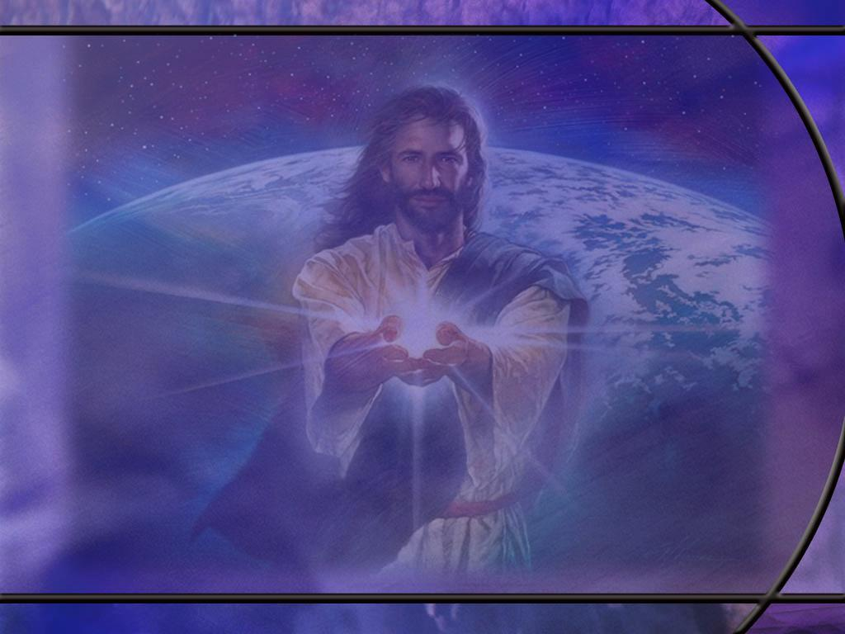
James 5:13 NKJV
Is anyone among you suffering? Let him pray. Is anyone cheerful? Let him sing psalms. [R]
Notes:
1. Actually, the word psalms is found only in the KJV and the NKJV translations.
2. Basically all the other translations render it “sing praises.”
3. And if you look it up in Strong’s concordance, there is a difference.
4. In Eph 5:19 the word translated Psalms is the GreeK word psalmos (psal-mos’).
5. But the word translated psalms here in James is the Greek word psallō (psal’-lo), which means to sing or make melody.
6. So it is usually translated as sing, or make melody, or sing praises.
7. Nevertheless the psalms are a wonderful way to sing praises to God.
8. Many psalms are prayers of praise that exalt God and give thanks for His goodness and grace.
9. We can use these inspired words as our own words of praise.

Slide 16
Past and Present
Psalm 44:1-2 ESV O God, we have heard with our ears, our fathers have told us, what deeds you performed in their days, in the days of old: ² you with your own hand drove out the nations, but them you planted; you afflicted the peoples, but them you set free;
Psalm 44:9, 11, 14 ESV - 9 But you have rejected us and disgraced us and have not gone out with our armies. ... 11 You have made us like sheep for slaughter and have scattered us among the nations. ... 14 You have made us a byword among the nations, a laughingstock among the peoples.
Notes:
Q1: How does the psalmist feel about the acts of God in Israel’s past history?
1. These were the good old days.
2. He looks back with fondness on how the Lord delivered His people from slavery in Egypt and gave them victory in the battles to lay claim to the Promised Land.
3. As spiritual Israel, we have the same view of the God of the Exodus who was able to work mighty miracles in order to save and deliver His people?
4. But that was in the distant past.
5. What about the working of God in the present?
[Click second bullet]
Q2: What happened to the God of the Exodus in the present age of the psalmist?
1. God seems not to care.
2. He seems to be indifferent to their plight.
3. They are like sheep ready to be slaughtered and where is their God of miracles now?
4. The psalmist laments in verse 11: “You have scattered us among the nations.”
5. If we look back at the author of this Psalm we find it was written by the sons of Korah.
6. Chronologically, many of the psalms of Korah came in the time period of the Assyrian crisis.
7. It was in 722 BC that the Assyrian army took the ten northern tribes captive and dispersed them to other countries and brought foreigners into Samaria and intermarried pagans with the Israelites there.
8. So this could be the difficult situation that has brought despair to the psalmist, but there may be a problem with that.
[Go to next slide.]

Slide 17
Innocence and Plea
Psalm 44:17-18 ESV - All this has come upon us, though we have not forgotten you, and we have not been false to your covenant. 18 Our heart has not turned back, nor have our steps departed from your way;
Psalm 44:23-24, 26 ESV - 23 Awake! Why are you sleeping, O Lord? Rouse yourself! Do not reject us forever! 24 Why do you hide your face? Why do you forget our affliction and oppression? ... 26 Rise up; come to our help! Redeem us for the sake of your steadfast love! [R]
Notes:
Q1: What do you think of this claim of innocence?
1. If this psalm really was written in response to the Assyrian captivity, it is difficult to see how these verses could apply to the nation as a whole.
2. Perhaps they might apply to a faithful remnant, but we know the record of persistent idolatry in the 10 tribes of the north.
3. The idolatry started with their first king, Jeroboam, and persisted throughout the entire history of the northern kingdom.
4. So maybe this is a writer from the southern tribes looking to avoid the disaster befalling their brothers to the north.
5. Once the northern 10 are defeated, the southern two are next in line.
6. So let’s next look at the plea made for deliverance here.
[Click second bullet.]
Q2: What plea does the psalmist make for action from the Lord?
1. Awake! Rouse Yourself! Come to our help! Redeem us!
2. In spite of the lack of action on God’s part, the psalmist still has his trust fixed firmly to God.
3. He is not looking to make an alliance with another nation.
4. He is not trusting in the arm of flesh.
5. He still has confidence in the love of the God we serve to redeem and deliver His people.

Slide 18
Psalm 22:14-18 NIV
I am poured out like water, and all my bones are out of joint. My heart has turned to wax; it has melted within me. ¹⁵ My mouth is dried up like a potsherd, and my tongue sticks to the roof of my mouth; you lay me in the dust of death. ¹⁶ Dogs surround me, a pack of villains encircles me; they pierce my hands and my feet. ¹⁷ All my bones are on display; people stare and gloat over me. ¹⁸ They divide my clothes among them and cast lots for my garment.
Notes:
1. This describes a suffering far beyond what David ever experienced himself.
2. But we see all of these prophecies fulfilled beautifully in the suffering of Christ at the crucifixion.
3. So how does David transition here from the depth of despair to the power of Praise?
4. Let’s continue with verse 19 as he makes his plea to God.
[Go to next slide.]

Slide 19
The Plea and the Praise
Psalm 22:19, 22-23, 27-28 NIV - 19 But you, LORD, do not be far from me. You are my strength; come quickly to help me. ... 22 I will declare your name to my people; in the assembly I will praise you. 23 You who fear the LORD, praise him! All you descendants of Jacob, honor him! Revere him, all you descendants of Israel! ... 27 All the ends of the earth will remember and turn to the LORD, and all the families of the nations will bow down before him, 28 for dominion belongs to the LORD and he rules over the nations. [R]
Notes:
Q1: In the depths of suffering and distress, to whom does the psalmist turn for help?
1. He calls upon the LORD, Yahweh, to be near to him, to be his strength, to come quickly to help him and deliver him from destruction.
2. And if we apply this to Jesus we can see that the Lord did not allow His holy one to see corruption as another psalm prophesies.
3. In three days the LORD raised Him back to life. (Really a few hours Friday, a few hours Sunday, and a full day Sabbath, 3 days using inclusive reckoning)
4. This psalm ends with a crescendo of praise that goes from the individual (I will praise you) to the assembly (you who fear the Lord praise Him) to all the families of the nations at the ends of the earth!
5. So this praise is consistent with the magnitude of redemption that results from the sacrifice of Christ for our sins on Calvary.
6. Worthy is the Lamb that was slain!!
7. Praise His holy name!

Slide 20
Psalm 13:1-6 NIV
How long, LORD? Will you forget me forever? How long will you hide your face from me? 2 How long must I wrestle with my thoughts and day after day have sorrow in my heart? How long will my enemy triumph over me?
3 Look on me and answer, LORD my God. Give light to my eyes, or I will sleep in death, 4 and my enemy will say, "I have overcome him," and my foes will rejoice when I fall.
5 But I trust in your unfailing love; my heart rejoices in your salvation. 6 I will sing the LORD's praise, for he has been good to me. [R]
Notes:
Q1: How does David start out in this psalm? How is he feeling?
1. He is feeling forgotten, separated from God; his heart is filled with sorrow; he feels like his enemies are winning.
2. He is feeling alone and defeated.
3. He feels like God is not listening when he prays.
4. So he starts out this psalm with his complaint or lament.
5. He is honest with God.
6. Here’s how I feel: I feel like you’ve forgotten me!
Q2: Do you think God wants us to be honest with Him?
1. This inspired psalm tells us that’s ok.
2. We don’t always have to put on a happy face.
3. Christians go through tough time too.
4. And when we’re hurting, God knows; so let’s be honest and build a relationship with God that is open and honest.
Q3: What plea does David make of the Lord in verse 3?
1. Look on me and answer, LORD my God.
2. He is confident that God is there and knows his needs.
3. He begs for answer to prayer and for deliverance from enemies.
4. He wants to feel the presence of God and know that He is near.
Q4: How does David end this prayer in verses 5 and 6?
1. He ends by confessing his trust in the unfailing love of God, and rejoicing in His salvation.
2. Recognizing God’s goodness, David sings His praise.
3. I imagine by this point, David is feeling a lot closer to the Lord and a lot less forgotten.

