Slide 1
Psalms
Lesson 10
Lessons of the Past

Slide 2
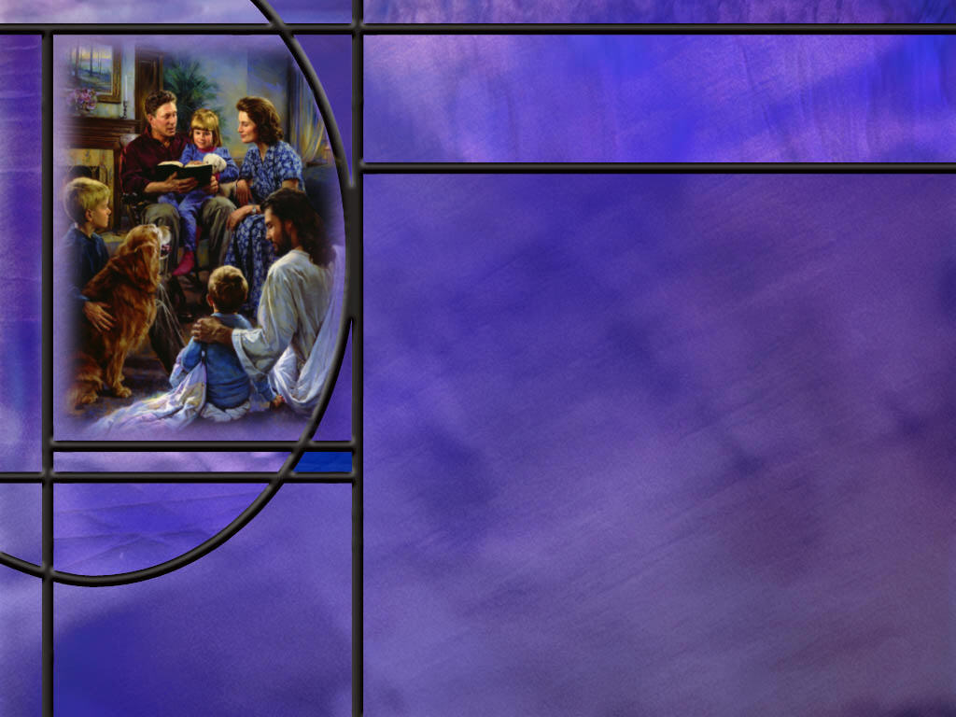
Memory Text
Psalm 78:3-4 NKJV
Which we have heard and known, And our fathers have told us. ⁴ We will not hide them from their children, Telling to the generation to come the praises of the LORD, And His strength and His wonderful works that He has done.
What important function of parents do we see in this psalm?
What kind of things does the psalmist recommend that we pass on to the next generation?
What things would you put on your list of the wonders that the Lord has done?
Notes:
B2:
1. Here in these verses we see the importance of parents educating their children and passing along truth to the next generation.
2. Our fathers have told us the mighty works of God in our past history and we will not hide these things from our children.
3. As a parent, have you felt the weight of that responsibility on your shoulders?
4. I certainly felt it as a young father.
5. My son was born in 1972 when I was still in graduate school at age 27.
6. His birth rocked my world.
7. I had rebelled against my Christian upbringing and declared myself an atheist during my college years.
8. But the miracle of his birth shook my evolutionary worldview, and I began to wonder: Can time and chance explain this perfect little baby?
9. And I decided that I better find out the truth about our origins so that I could pass along that truth to my children.
10. As I began to look into the scientific evidence that supported creation I was amazed.
11. As I studied the evidence, I became convinced that creation was true.
12. There is no way that life could have happened by accident.
13. For every question I had, it seemed God had an answer.
14. When we first moved to Hanover, MA, a neighbor stopped by and invited us to church.
15. We went, and I started hearing the Gospel again.
16. The one question that began to burn in my mind was this: Is Christianity true?
17. I didn’t care whether it made people happy or gave them a sense of peace or made them love their neighbors... I wanted to know: Is it true?
18. So I began to study the Bible and books about the Bible.
19. And I came to the conclusion that the Bible is God’s word, that Jesus is God’s Son, that He died for my sins, and that He offers me eternal life by grace through faith.
20. And that’s the truth that I have tried to pass along to the next generation.
21. Is there a more important mission field that the young people in our families?
22. May we resolve with the psalmist, Asaph here, that “we will not hide [the truth] from [our] children.”
B3:
1. He gives three things here that we should pass on to the next generation:
2. The praises of the Lord, His strength, and His wonderful works.
3. The NIV renders it: “the praiseworthy deeds of the LORD, his power, and the wonders he has done.”
B4:
1. I am sure our list could go on and on as we get into the details.
2. But for me there are two overarching reasons to praise and worship God: creation and redemption.
3. When we think of creation, how God called the universe into existence by the power of His word, that truly is a praiseworthy deed that displays His power and the wonders He has done.
4. When we see the living things He has created, so complex and intricate and well designed and beautiful, truly that is praiseworthy and displays His power and wonderful genius.
5. The miracle of creation is beyond our ability to grasp.
6. But when He saved my soul! Hallelujah!
7. When God sent His only Son to die for my sins, what a praiseworthy deed!
8. This amazing grace demonstrated the power of the gospel, the power in the blood of Jesus to forgive sins.
9. And what a wonderful work to offer us eternal life through justification by faith rather than the eternal death we deserve.
10. Hymn 111 summarizes it so nicely:
It took a miracle to put the stars in place,
It took a miracle to hang the world in space,
But when He saved my soul,
Cleansed and made me whole,
It took a miracle of love and grace!

Slide 3
Overview
The psalms in our lesson this week are historical psalms that recount God’s praiseworthy deeds and wonderful works in the past. He has been faithful to His covenant promises in spite of the repeated failures and unfaithfulness of His people. These psalms caution us against repeating their rebellion and encourage us to learn from their mistakes.
  For Our Admonition
  Ps 78 and 105
  Ps 106 and 135
  Summary

Slide 4
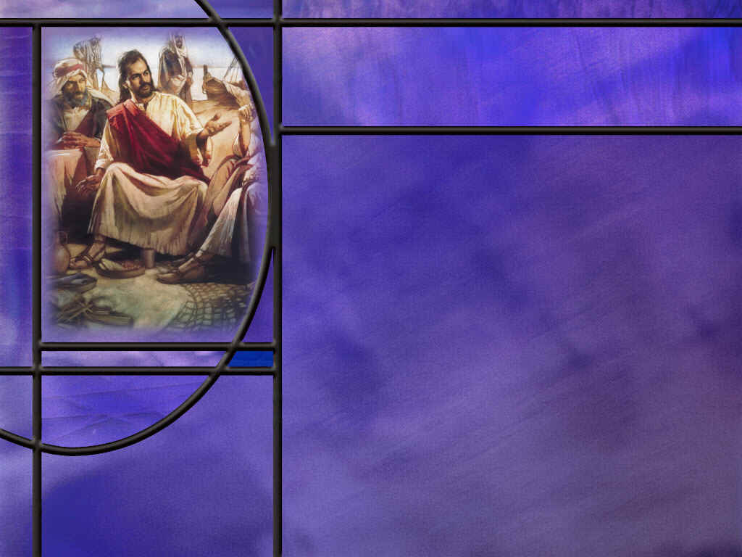
For Our Admonition
Looking at the OT Scriptures, what value did the apostle Paul see in them for us today? (2 Tim 3:15-17)
Recounting the experience of God’s people in the wilderness, what happened to them and why were these things recorded in Scripture? (1 Cor 10:6-11)
In what sense are the OT Scriptures a history of our ancestors, not just a history of the Jews today? (Gal 3:28-29)
Notes:
B1:
[See notes on linked slide.]
B2:
[See notes on linked slide.]
B3:
[See notes on linked slide.]

Slide 5
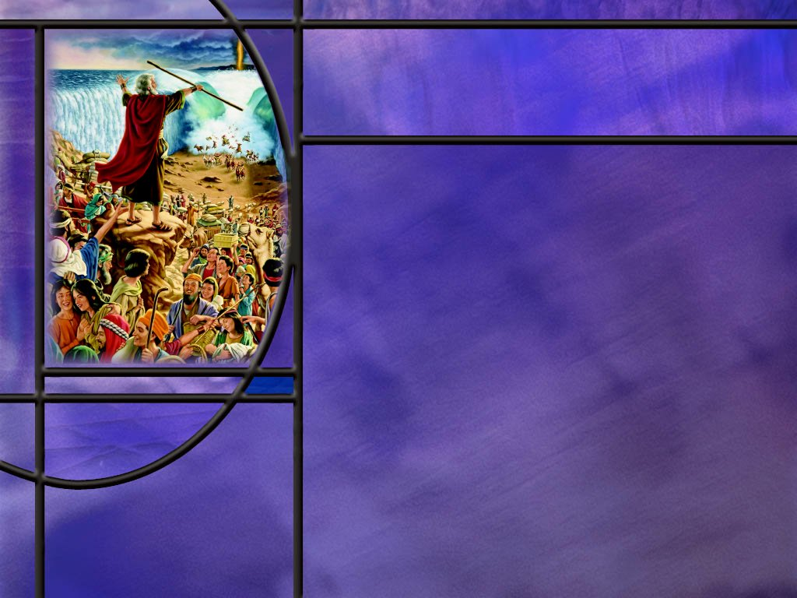
Ps 78 and 105
What are some of the key verses in Ps 78 that show the stubbornness and rebellion of God’s people in the wilderness? (Ps 78:10-58)
How does Ps 105 paint a much more positive picture of the history of God’s people during the wilderness experience? (Ps 105:1-45)
Notes:
B1:
1. This is a very long Psalm of some 78 verses.
2. It goes on and on about how God delivered His people from Egyptian bondage and led them out with a mighty arm.
3. But they forgot His mighty acts and miracles of deliverance and provision in the desert.
4. So the psalm goes back and forth between the mighty acts of God and the rebellion of His people.
[See notes on linked slide.]
B2:
1. Psalm 105 has 45 verses and not one of them has negative thing to say about the people and their unfaithfulness to God.
2. It is all about God faithfulness to His covenant and how He sent Joseph to Egypt before them.
3. How He delivered them from Egypt and provided for them in the wilderness.
4. This is a psalm that praises God for His goodness and doesn’t even mention the unfaithfulness of His people.
[See notes on linked slide.]
B3:
[See notes on linked slide.]

Slide 6
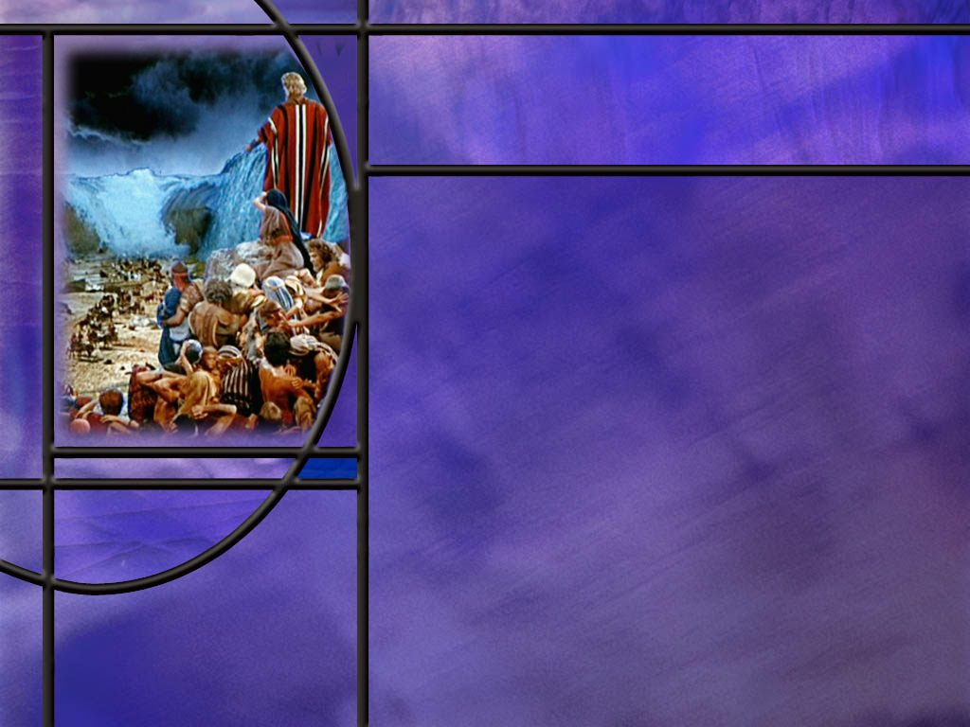
Psalm 106 and135
How do the last two verses of Ps 106 set the context for the theme of this psalm? (Ps 106:47-48)
What are some of the sins confessed in Ps 106? (Ps 106:6-46)
How does Ps 135 describe the idols of the nations surrounding Israel? (Ps 135:15-18)
What did the apostle Paul write about idols that makes them even worse than a lifeless image of silver or gold? (1 Cor 10:19-20)
Notes:
B1:
[See notes on linked slide.]
B2:
[See notes on linked slide.]
B3:
[See notes on linked slide.]
B4:
[See notes on linked slide.]

Slide 7

Summary
All Scripture is breathed out by God and profitable for teaching, for reproof, for correction, and for training in righteousness.
This includes specifically the OT historical accounts of God’s dealing with His people which the apostle Paul says was written for our admonition or instruction.
As believers in Christ, Paul writes that we are Abrahams seed, so our spiritual roots go back to the OT patriarchs of Abraham, Isaac, and Jacob. Paul refers to the Christian church as the Israel of God.
The psalms in our lesson this week recount the praiseworthy deeds and wonderful works of the Lord, which were often not remembered or fully appreciated by His people.

Slide 8
Summary
Psalm 78 emphasizes the failures of God’s people, particularly in the exodus. It reminds us not to forget the mighty works of God in our past history and have faith that we worship the same God today.
Ps 105 also covers the Exodus narrative but without a single mention of the unfaithfulness of God’s people.
This psalm gives all the glory to God and can serve as a type of God’s deliverance of us from slavery to sin to peace, rest, and obedience in God’s eternal kingdom.
Ps 106 is apparently written by an exile in Babylon. Like Daniel’s prayer in Dan 9, it is a psalm of corporate repentance, confessing the multitude of sins that has resulted in their captivity.

Slide 9
Summary
This psalm again warns us from following their evil ways.
Psalm 135 describes the foolishness of worshipping images that cannot speak, see, hear, or breathe.
But such images are not simply neutral by being inanimate, they become the habitation of demons who are only too happy receive the worship of those they ensnare.
Psalm 78 opens with an appeal to pass on to our children “the praiseworthy deeds of the LORD, his power, and the wonders he has done.”
Will you accept that challenge this week to pass along to your family members the wonderful works of God, particularly seen in His creation and redemption?

Slide 11
2 Timothy 3:15-17 KJV
And that from a child thou hast known the holy scriptures, which are able to make thee wise unto salvation through faith which is in Christ Jesus. ¹⁶ All scripture is given by inspiration of God, and is profitable for doctrine, for reproof, for correction, for instruction in righteousness: ¹⁷ That the man of God may be perfect, thoroughly furnished unto all good works. [R]
Notes:
Q1: What Scriptures do you think the apostle Paul had in mind when he wrote these verses?
1. Well the holy scriptures that Timothy had as a child would have been just the OT scriptures.
2. The NT canon of Scriptures was by no means complete even as Paul was writing this.
3. Paul says that “all Scripture” is God-breathed or inspired by God, so this would certainly include the OT scriptures.
Q2: And what are the OT scriptures profitable for?
1. For doctrine, for reproof, for correction for instruction in righteousness.
2. So Paul is saying we need to pay attention to the things that are written in the Scriptures.
3. And we need to apply their lessons to ourselves so that we can be profited by their teaching and be reproved, corrected and instructed in righteousness.
4. So in the psalms we are studying this week, we need to apply them to ourselves.

Slide 12
1 Corinthians 10:6-11 NKJV
Now these things became our examples, to the intent that we should not lust after evil things as they also lusted. 7 And do not become idolaters as were some of them. As it is written, "The people sat down to eat and drink, and rose up to play." 8 Nor let us commit sexual immorality, as some of them did, and in one day twenty-three thousand fell; 9 nor let us tempt Christ, as some of them also tempted, and were destroyed by serpents; 10 nor complain, as some of them also complained, and were destroyed by the destroyer. 11 Now all these things happened to them as examples, and they were written for our admonition, upon whom the ends of the ages have come. [R]
Notes:
Q1: Why does Paul say all these things happened to them?
1. They were examples to us, and they were written down for our admonition or instruction.
2. God wants us to learn from their mistakes so that we don’t make the same mistakes ourselves.
3. God is instructing us by giving us an account of the victories and defeats in the history of His people.
4. Through it all we see the faithfulness of God in spite of the unfaithfulness of His people.
5. But the disobedience brought discipline and difficulties, death and defeat.
6. So Paul says, let’s not lust after evil things as they also lusted.
7. Obedience brings blessings and fellowship with our Lord.
8. God’s commandments are given to us for our own good, and life is always better when we obey.

Slide 13
Galatians 3:28-29 NKJV
There is neither Jew nor Greek, there is neither slave nor free, there is neither male nor female; for you are all one in Christ Jesus. ²⁹ And if you are Christ's, then you are Abraham's seed, and heirs according to the promise. [R]
Notes:
Q1: Who are the descendants of Abraham according to this verse?
1. All those who are Christ’s are Abraham’s seed.
2. So Abraham is our father because we are in Christ, and Christ was the seed of Abraham who, according to the covenant, would bring blessings to all the families of the world.
3. What a blessing to be Abraham’s seed and be an heir of the promises of God!
4. So Paul makes this plain in other verses as well.
Romans 2:28-29 NKJV - For he is not a Jew who is one outwardly, … 29 but he is a Jew who is one inwardly;
5. He ends Galatians by referring to the Christian church as “the Israel of God.”
6. In Romans 11, he talks about the natural branches being broken off of the olive tree, which is Israel, and the wild olive branches, the Gentiles, being grafted in.
7. Peter applies the old testament titles of Israel to the Christian church:
1 Peter 2:9-10 NKJV - 9 But you are a chosen generation, a royal priesthood, a holy nation, His own special people, that you may proclaim the praises of Him who called you out of darkness into His marvelous light; 10 who once were not a people but are now the people of God, who had not obtained mercy but now have obtained mercy.
8. So as Spiritual Israel, we are now God’s chosen people, His treasured possession.
9. And our spiritual roots go back to Abraham, Isaac, and Jacob.
10. Our spiritual ancestors were slaves in the land of Egypt and God brought them out with a mighty arm.
11. As we consider these historical psalms, let us be aware that they are the history of our own spiritual ancestors.

Slide 14
Psalm 78:10-11, 17-20, 32 ESV
They did not keep God's covenant, but refused to walk according to his law. 11 They forgot his works and the wonders that he had shown them. ... 17 Yet they sinned still more against him, rebelling against the Most High in the desert. 18 They tested God in their heart by demanding the food they craved. 19 They spoke against God, saying, "Can God spread a table in the wilderness? 20 He struck the rock so that water gushed out and streams overflowed. Can he also give bread or provide meat for his people?" ... 32 In spite of all this, they still sinned; despite his wonders, they did not believe. ...
Notes:
[Go to next slide.]

Slide 15
Ps 78:36-37, 40-42, 58 ESV
36 But they flattered him with their mouths; they lied to him with their tongues. 37 Their heart was not steadfast toward him; they were not faithful to his covenant. ... 40 How often they rebelled against him in the wilderness and grieved him in the desert! 41 They tested God again and again and provoked the Holy One of Israel. 42 They did not remember his power or the day when he redeemed them from the foe, ... 58 For they provoked him to anger with their high places; they moved him to jealousy with their idols. [R]
Notes:
Q1: Why such emphasis in this psalm on the failure of God’s people?
1. Once again we see that the Bible records the unvarnished truth of our fallenness.
2. And our tendency to forget is a warning that this psalm reminds us to pass along to the next generation.
3. This is a warning to us not to forget God’s mighty acts in the history of His people.
4. The Israelites that God delivered from Egypt saw the Lord’s power to deliver; they saw the Red Sea parted and crossed on dry ground.
5. The waters covered their enemies and drowned them in the sea.
6. God provided manna in the wilderness and water to drink, yet they continued to murmur in their discontent with the provisions of God.
7. Time and time again they failed to trust in the Lord.
8. And the lesson comes down to us: Don’t forget the mighty works of God in our past history and have faith that we worship the same God today.
9. Keep reminding ourselves by meditating on the mighty works of our God, especially in creation and redemption.
10. Let us trust God to provide and deliver.
11. As Paul wrote in:
1 Corinthians 10:12 ESV - 12 Therefore let anyone who thinks that he stands take heed lest he fall.
12. If it happened to them, it can happen to us.
13. We are not beyond the reach of temptation.
14. All of us have fallen and brought disgrace to the name of our Lord.
15. But God is faithful to offer us forgiveness through the blood of Jesus and restoration to fellowship with Him.

Slide 16
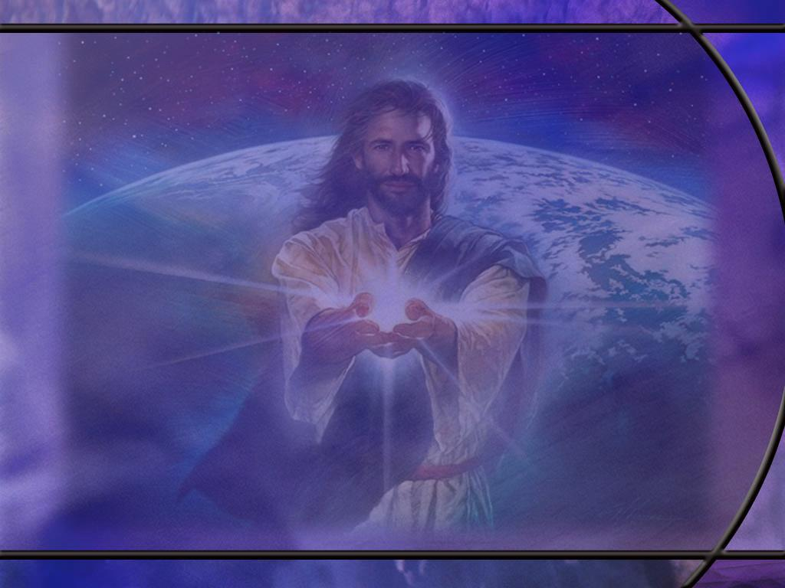
Psalm 105:1, 8, 37, 40, 43-45 ESV
Oh give thanks to the LORD; call upon his name; make known his deeds among the peoples! ... 8 He remembers his covenant forever, the word that he commanded, for a thousand generations, ... 37 Then he brought out Israel with silver and gold, and there was none among his tribes who stumbled. ... 40 They asked, and he brought quail, and gave them bread from heaven in abundance. ... 43 So he brought his people out with joy, his chosen ones with singing. 44 And he gave them the lands of the nations, and they took possession of the fruit of the peoples' toil, 45 that they might keep his statutes and observe his laws. Praise the LORD! [R]
Notes:
Q1: Who gets the glory for this historical account of the history of God’s people?
1. It’s all about God and what He did to deliver His people and lead them from slavery in Egypt to a new home in the promised land.
2. There is not a single verse that mentions the unfaithfulness of God’s people.
Q2: So what should we learn from this historical account of God’s mighty acts in the deliverance of His people?
1. Here we see a picture of the mighty works of God: His provision, His power, His deliverance, and the glory and praise go to Him.
2. God delivers His chosen people from slavery and leads them into the promised land where they keep His statutes and observe His laws.
3. And we can look at this as a model or a type of what Christ is doing for us.
4. He is leading us from enslavement to sin to the promised land of His kingdom.
5. There, once the curse is lifted, we will keep His statutes and observe His laws.
6. In Christ we have become the “Israel of God” and “heirs of the promise.”
7. And the promise of which we are heirs is the promise of the everlasting covenant of salvation by faith, for which the faithful are promised eternal life.
8. We have even more reason to praise the Lord than the Israelites did.
9. The Lord led them to a land of milk and honey to live a few more years.
10. He is leading us to His kingdom to live forever! Praise the LORD!!

Slide 17
Psalm 106:47-48 ESV
Save us, O LORD our God, and gather us from among the nations, that we may give thanks to your holy name and glory in your praise. 48 Blessed be the LORD, the God of Israel, from everlasting to everlasting! And let all the people say, "Amen!" Praise the LORD! [R]
Notes:
Q1: From where is the psalmist writing this psalm?
1. It looks like the psalmist is scattered among the nations.
2. Most likely he is a part of the captives in Babylon.
4. His plea to God is for restoration of God’s people that were scattered among the nations.
Q2: Do you remember Daniel’s prayer in the first part of chapter 9? He was praying for God to restore His people as well. What kind of confession did Daniel make as He lifted his prayer to God?
1. Daniel prayed a prayer of corporate confession.
2. He confessed the sins of his people, acknowledging their sins and asking for forgiveness.
3. Here’s how he begins his prayer:
Daniel 9:4-6 ESV - I prayed to the LORD my God and made confession, saying, "O Lord, the great and awesome God, who keeps covenant and steadfast love with those who love him and keep his commandments, 5 we have sinned and done wrong and acted wickedly and rebelled, turning aside from your commandments and rules. 6 We have not listened to your servants the prophets, who spoke in your name to our kings, our princes, and our fathers, and to all the people of the land.
4. Verse after verse, Daniel goes on confessing the sins of his people.
5. This is corporate repentance for corporate sins, not that Daniel was guilty himself, but he was part of a community that was responsible for sinning against God.
6. Here we have this same corporate confession in Psalm 106.
7. Here we have a stark contrast to Ps 105.
8. Whereas, Psalm 105 had not one bad thing to say about the people that God delivered, Psalm 106 has nothing good to say about them.
9. In effect, this psalm is a confession of their sins throughout their history that culminated in God allowing them to be carried off into captivity.

Slide 18
Psalm 106:6, 13-14, 19, 24-25 ESV
Both we and our fathers have sinned; we have committed iniquity; we have done wickedness. ... 13 But they soon forgot his works; they did not wait for his counsel. 14 But they had a wanton craving in the wilderness, and put God to the test in the desert; ... 19 They made a calf in Horeb and worshiped a metal image. ... 24 Then they despised the pleasant land, having no faith in his promise. 25 They murmured in their tents, and did not obey the voice of the LORD. ...
Notes:
[Go to next slide.]

Slide 19
Psalm 106:28, 32, 34, 36-38 ESV
28 Then they yoked themselves to the Baal of Peor, and ate sacrifices offered to the dead; ... 32 They angered him at the waters of Meribah, and it went ill with Moses on their account, ... 34 They did not destroy the peoples, as the LORD commanded them, ... 36 They served their idols, which became a snare to them. 37 They sacrificed their sons and their daughters to the demons; 38 they poured out innocent blood, the blood of their sons and daughters, whom they sacrificed to the idols of Canaan, and the land was polluted with blood. [R]
Notes:
1. Wow! No wonder they were disciplined by the Lord.
2. What a litany of transgressions, sins, and iniquity.
Q1: What do you think the Lord wants us to learn from this psalm of corporate confession?
1. Don’t do what they did.
2. Don’t sin like they sinned.
3. Be warned away from any of these acts that break the heart of God.
Q2: But did God give up on His people?
1. He was patient for hundreds of years.
2. He sent prophet after prophet to call His people back to faithfulness and obedience.
3. Finally, He had to act to discipline His people and straighten them out.
4. Even in this psalm of confession we find hope of restoration.
5. Just before the last two verses of the psalm that we read before, we read this:
Psalm 106:44-46 NKJV - Nevertheless He regarded their affliction, When He heard their cry; 45 And for their sake He remembered His covenant, And relented according to the multitude of His mercies. 46 He also made them to be pitied By all those who carried them away captive.
6. Finally, when they were restored to the land and the temple was rebuilt under Ezra and Nehemiah, it looks like they got the message.
7. Idolatry was put away and God could prepare His people for the arrival of the Messiah.

Slide 20
Psalm 135:15-18 ESV
The idols of the nations are silver and gold, the work of human hands. 16 They have mouths, but do not speak; they have eyes, but do not see; 17 they have ears, but do not hear, nor is there any breath in their mouths. 18 Those who make them become like them, so do all who trust in them. [R]
Notes:
Q1: How does this description contrast with Yahweh, the God of the Israelites?
1. They have mouths but cannot speak; God speaks and the universe comes into existence.
Psalm 33:6 ESV - 6 By the word of the LORD the heavens were made, and by the breath of his mouth all their host.
2. They have eyes but cannot see; God sees all and knows all:
Hebrews 4:13 ESV - … no creature is hidden from his sight, but all are naked and exposed to the eyes of him to whom we must give account.
3. They have ears but cannot hear; God hears every prayer even if prayed silently:
1 John 5:14 ESV - 14 And this is the confidence that we have toward him, that if we ask anything according to his will he hears us.
4. They have no breath in their mouths; but God’s breath produces living souls.
Genesis 2:7 ESV - then the LORD God formed the man of dust from the ground and breathed into his nostrils the breath of life, and the man became a living creature.
Q2: What do you make of verse 18 that says [read again].
1. The final destiny of those who worship idols is that they become blind, deaf, dumb, and dead.
2. They will become as dead as their idols when they are consumed in the lake of fire.
3. The first two commandments deal with idolatry.
4. The first, Thou shalt have no other gods before me.
5. The second, Thou shalt not worship a graven image.
Q2: Do you see a principle here in verse 18? By beholding we become changed?
1. Paul describes it in:
2 Corinthians 3:18 ESV - 18 And we all, with unveiled face, beholding the glory of the Lord, are being transformed into the same image from one degree of glory to another. For this comes from the Lord who is the Spirit.
2. What we behold with admiration we come to reflect.
3. Let’s make sure we make Jesus the object of our highest admiration, so that we can be changed into His likeness.

Slide 21
1 Corinthians 10:19-20 ESV
What do I imply then? That food offered to idols is anything, or that an idol is anything? ²⁰ No, I imply that what pagans sacrifice they offer to demons and not to God. I do not want you to be participants with demons. [R]
Notes:
Q1: Who is it that occupies the idols that men set up to worship and pray to?
1. This is Satan’s ground.
2. These idols become the habitation of demons and they can often manipulate circumstances to make it appear they have power to answer prayer.
3. In this way they keep those who worship them enslaved to demonic powers.

