Slide 1
The Great Controversy
Lesson 1
The War Behind All Wars

Slide 2
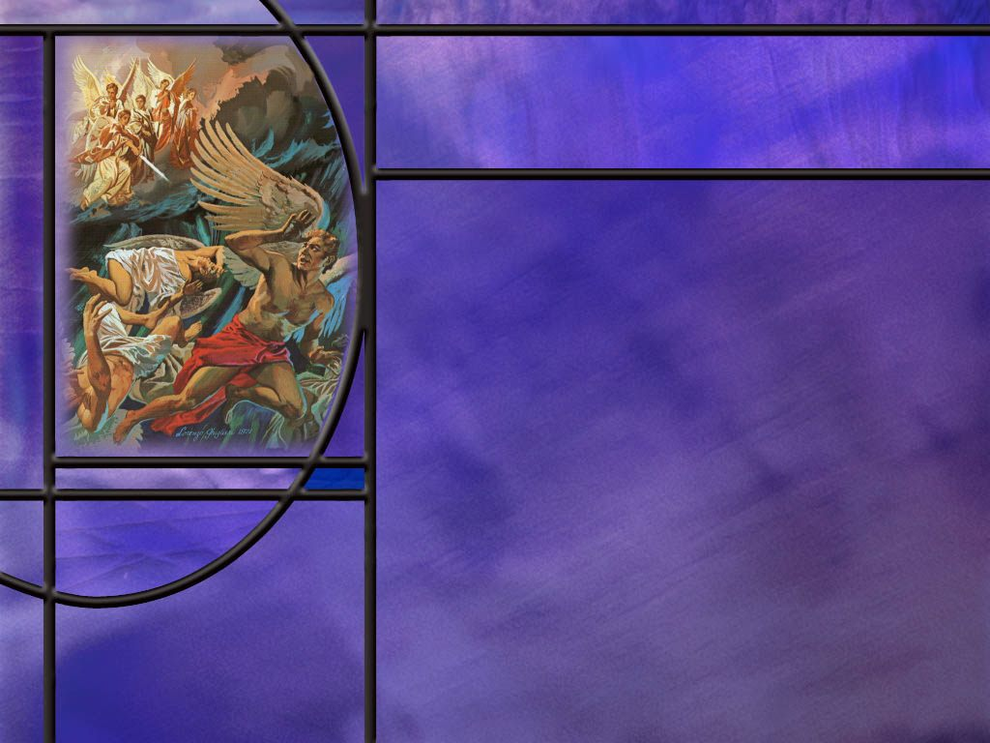
Memory Text
Revelation 12:7-8 NKJV
And war broke out in heaven: Michael and his angels fought with the dragon; and the dragon and his angels fought, but they did not prevail, nor was a place found for them in heaven any longer.
What is startling about the location of this war?
Who are the leaders of the opposing forces in this war?
Notes:
B2:
1. It broke out in heaven of all places!!
2. We are very familiar with war on earth, but war in heaven?
3. How could there be war in heaven, a perfect place where God Himself dwells?
4. This goes back to the original rebellion of Lucifer.
5. Many think sin originated in the Garden of Eden, but the original rebellion was in heaven and the original rebel was Lucifer.
B3:
1. We have Michael and His angels fighting against the dragon and his angels.
2. What do we know about Michael? Who is He?
3. In short, He is the preincarnate Son of God, the second person of the trinity who, in the incarnation, became Jesus of Nazareth, died for our sins, rose again, and ministers now as our great high priest in heaven.
4. What biblical evidence supports that idea?
5. First, it was Michael the archangel who disputed with the devil in the resurrection of Moses. (Jude 1:9)
6. Michael prevailed in that conflict, because Moses appeared to Jesus and His disciples on the Mt. of Transfiguration.
7. Angels do not have the power to resurrect the dead, but Jesus, the Son of God, does.
8. He is the resurrection and the life.
9. Second, when Jesus returns to resurrect the dead, Paul writes that “the Lord Himself shall descend from heaven with a shout, with the voice of the archangel, and with the trump of God.” (1 Thes 4:16)
10. The voice of the archangel, Michael, then is the voice of the Lord Jesus Himself that calls the dead back to life.
11. Jesus said:
John 5:28-29a Do not marvel at this, for the hour is coming in which all who are in the graves will hear His voice [the voice of Jesus] and come forth….
12. Third, the Michael who comes to Gabriel’s aid in Daniel 10 to defeat Satan (in the form of the prince of the kingdom of Persia) is a chief prince of God’s people, implying His royalty and coming kingship.
13. Fourth, when Michael stands up in Daniel 12, there is a mighty resurrection, but the NT makes it clear that it is Jesus Christ who comes to resurrect the dead.
14. Fifth, we see in our memory text that Michael is the leader of the angelic hosts of Yahweh.
15. As such He is Captain or Commander of the LORD’s host.
16. He appeared to Joshua at Jericho with His sword drawn and identified himself as the Captain or Commander of the LORD’s host.
17. And he told Joshua, “Take your sandal off your foot for the place where you stand is holy.”
18. Only God can make the ground holy by His presence.
19. So Michael the archangel is the divine Son of God.
20. That makes sense to me.
21. God’s only Son is the Father’s emissary of love both to angels, as Michael, and to humans as Michael in the OT and as Jesus in the NT.
22. Well what about the dragon? Who is he?
23. Verse 9 of Rev 12 leaves no doubt:
Rev 12:9 KJV: The great dragon was cast out, that serpent of old, called the Devil and Satan, who deceives the whole world…
24. So we have four names that leave no doubt: dragon, serpent, Devil, and Satan.
25. And we also have his job description: he deceives the whole world.

Slide 3
Overview
The Bible provides tantalizing glimpses behind the scenes of a spiritual battle between good and evil that began in heaven and is now raging on earth where God is working out His plan for the final defeat of evil. On Calvary, Christ won the decisive battle in that cosmic conflict, and is able to save to the uttermost all those who come to Him in faith, seeking forgiveness and redemption.
  War in Heaven
  Battleground on Earth
  Victory at Calvary
  Summary

Slide 4
War in Heaven
How does the Bible describe the origin of the great controversy? (Rev 12:7-9)
How could a perfect being (Lucifer) in a perfect environment (heaven) fall into sin and rebellion against a perfect God?
How does Ezekiel describe the rebellion of Lucifer as part of a prophecy against the king of Tyre? (Ezekiel 28:12-15)
What does Isaiah add to our understanding of Satan’s rebellion against God in his prophecy against the king of Babylon? (Isa 14:12-15)
How can we avoid the pride that caused Lucifer’s fall and places self on the throne instead of God?
Notes:
B1:
[See notes on linked slides.]
B2:
1. God created angels and mankind with the freedom to choose.
2. That freedom can be either used to choose right or wrong.
3. Of course, God wants us to choose right, but He will not prevent us from choosing wrong.
4. We can imagine that God tried to persuade Satan to give up his rebellious plans.
5. But in the end, Satan’s choice initiated the long war against God.
B3:
[See notes on linked slide.]
B4:
[See notes on linked slide.]
B5:
1. We need humility instead of pride.
2. Humility is the response of the heart to a true knowledge of who God is and who we are.
3. And a true knowledge of God comes from the word of God, the Bible.
4. There we learn that God is creator, redeemer, restorer, sustainer.
5. He is God almighty: omnipotent, omniscient, omnipresent, transcendent, imminent.
6. And we are sinners saved by His grace.
7. With God, all things are possible.
8. But Jesus said, without me ye can do nothing, at least nothing of enduring value.
9. We can do nothing to forgive our own sins and reconcile ourselves to God.
10. Like the publican in Jesus’ parable, we can only be justified by crying out, God, be merciful to me a sinner.
11. God lays man’s pride in the dust at the foot of the cross.
12. There we realize we cannot save ourselves.
13. We can only trust in the doing and dying of Jesus to save us.
14. Humility is one aspect of the fruit of the Spirit.
15. The closer we come to Jesus the more we will trust Him instead of ourselves.

Slide 5
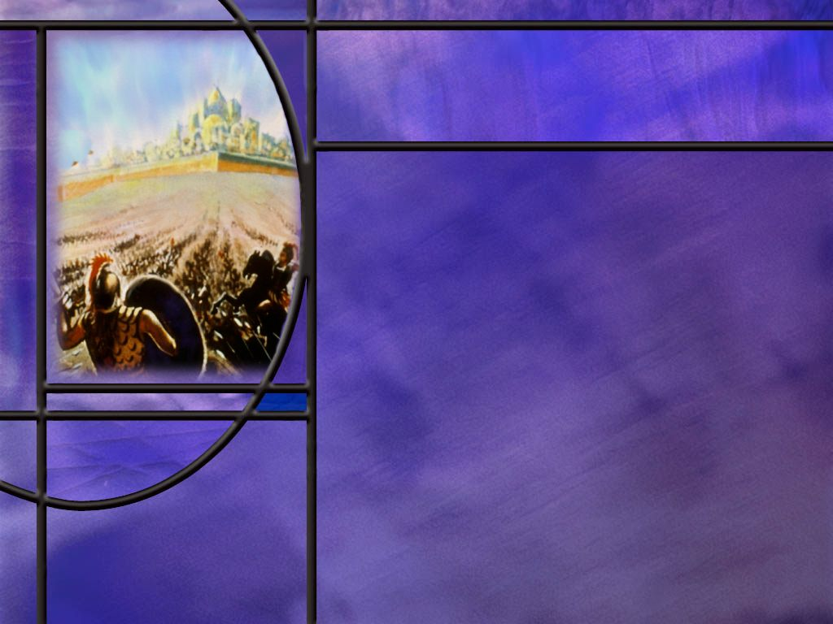
Battleground on Earth
Why did God not simply destroy Satan for his rebellion instead of casting him down here to tempt us?
What does it tell you about God that He created beings with the freedom to choose?
What choice did God place before Adam and Eve and of what consequence did He warn them? (Gen 3:1-3)
As the book of Revelation closes, what final choice does the Lord place before those who read? (Rev 22:17)
What famous choices did Joshua, Moses, and Elijah set before the people in OT times? (Make a Choice)
Notes:
B1:
1. If sin could arise in Lucifer’s heart, it could arise in anyone’s heart.
2. He was created perfect and he stood next to the throne of God.
3. God needed a way to inoculate His creation against rebellion and sin.
4. And so God decided to allow the rebellion to play out so that all could see its bitter fruit.
5. Today we live under the curse.
6. Our lives are plagued by sickness, disease, sorrow, pain, depression, suicide, mental illness, cancer, heart disease, and ultimately death.
7. We are born with fallen natures with the propensity to sin.
8. Our world is full of evil: murder, drugs, immorality, prostitution, homosexuality, stealing, lying, swearing, pride, greed, atheism.
9. God’s purpose in allowing all of this is to make us good and sick of sin.
10. When, in the future, we are living in God’s kingdom, who would want to come back to this?
11. So God is using the Great Controversy to inoculate us against rebellion against the God who created us and loves us with an everlasting love.
12. Also, if God had destroyed Satan immediately, the angels would have served Him out of fear rather than love.
13. In time, the love of God was clearly demonstrated as He sent His Son to die for our sins.
14. At the same time Satan was revealed as a murderer and a liar.
B2:
1. The greatest relational attribute of God is this: God is love.
2. Can there be real love without freedom to choose?
3. Love cannot be forced.
4. Love is choosing to act in someone’s eternal best interest.
5. If we have no ability to choose, we have no ability to love.
6. So God gave us the ability to make choices which have a profound effect on our future.
7. We can choose to love God because He first loved us or to reject Him in favor of what Satan offers us.
8. That choice determines our destiny.
B3:
[See notes on linked slide.]
B4:
[See notes on linked slide.]
B5:
[See notes on linked slide.]

Slide 6
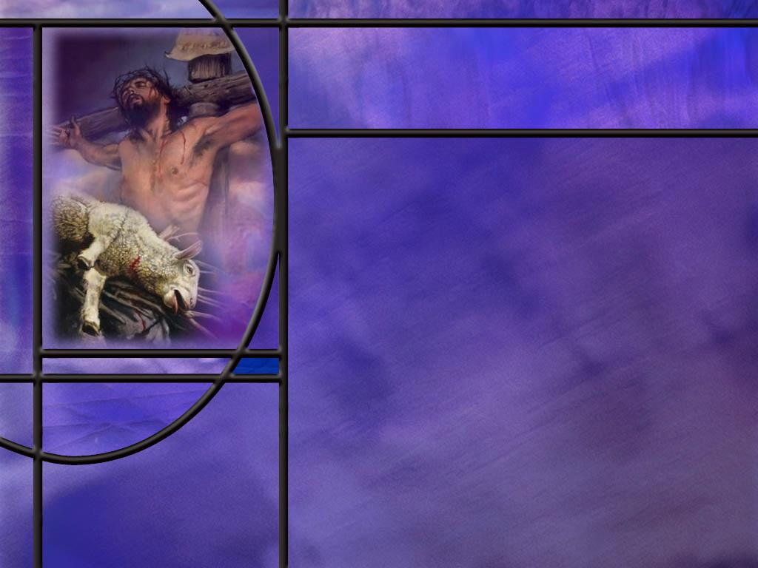
Victory at Calvary
What is the good news that balances the bad news that Satan has engaged us in battle and is intent on leading us to perdition? (Rev 12:10-11)
Revelation 12 the first part of the Great Controversy visions of Revelation. How does the structure of this chapter point to this good news as its central message. [Structure]
What reason does the apostle John give for Christ’s mission to earth? (1 John 3:8)
What is Jesus doing for us now in the heavenly sanctuary? (Heb 7:25)
What promise of Christ’s victory in the Great Controversy did God give Adam and Eve as soon as they sinned? (Gen 3:15)
Notes:
B1:
1. Let’s go back to the book of Revelation that describes the GC in Chapter 12.
2. We pick up right after the verses we have already studied about how Satan was cast out of heaven and his angels were cast out with him.
[See notes on linked slide.]
B2:
[See notes on linked slide.]
B3:
[See notes on linked slide.]
B4:
[See notes on linked slide.]
B5:
[See notes on linked slide.]

Slide 7

Summary
God is love, and part of being created in His image is having the capacity to understand His love and have the capacity to love Him in response to His love for us.
Since love cannot be forced, God took the risk of creating intelligent beings with the freedom of choice.
Beginning with Lucifer and continuing with the human race, that freedom of choice has been used to rebel against God.
God’s plan in allowing the GC to continue is to save a remnant who will trust in Jesus for forgiveness and eternal life and will be inoculated against sin and rebellion in the kingdom to come by their experience of the evil, suffering, pain, death, and destruction of this fallen world.

Slide 8
Summary
The good news in the battle scenes of Revelation 12 is found in Rev. 12:10-11.
The main focus of this chapter and perhaps of the whole book of Revelation is the battle scene in heaven between Christ and Satan.
Here we see Satan cast out of heaven, defeated at the cross, overcome by saints who trust the blood of Jesus, and cast out as the ruler of this world.
It was at the cross that the evil of Satan was fully unmasked and the grace and love of God was fully displayed.
By His death, Christ fully paid the price of redemption for all mankind, opening the way for us to be saved by grace through faith.

Slide 9
Summary
The Fall and the curse resulted in a dramatic change in God’s good creation, the most serious of which was death for all and the implied change that all would be born with fallen natures having a propensity to selfishness and sin.
But God did not leave us without hope. The central focus of Genesis 3 is the promise of Gen 3:15 that God would send the Seed of the woman to crush the serpent’s head.
This is a Messianic prophecy that implies a triumphant end for Christ in the Great Controversy and for all those who trust the blood of the Lamb for forgiveness.
Will you choose to trust His blood today that you might be among the redeemed that witness the fulfillment of the promise: “there shall be no more curse?”

Slide 11
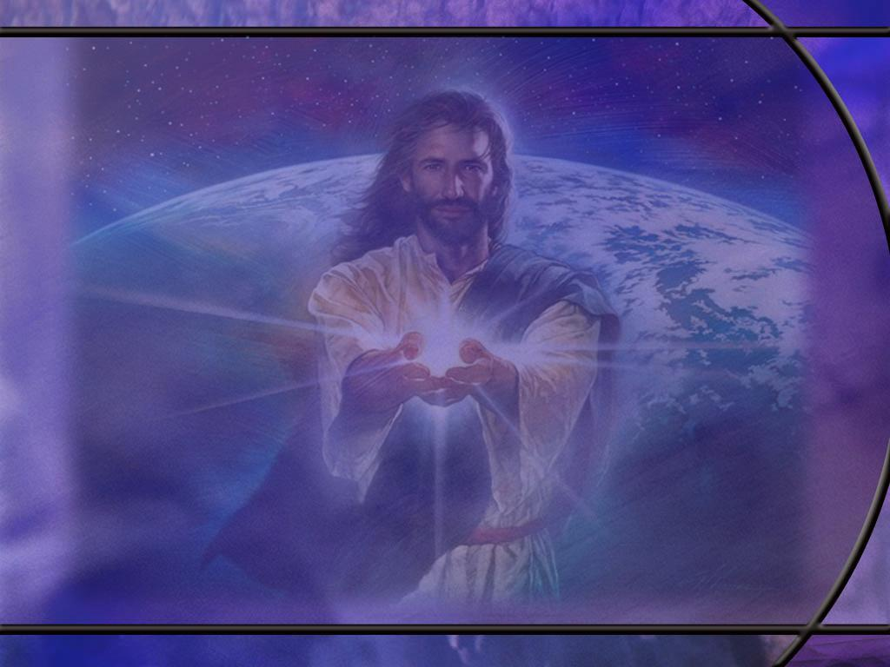
Revelation 12:7-9 KJV
And there was war in heaven: Michael and his angels fought against the dragon; and the dragon fought and his angels, 8 And prevailed not; neither was their place found any more in heaven. 9 And the great dragon was cast out, that old serpent, called the Devil, and Satan, which deceiveth the whole world: he was cast out into the earth, and his angels were cast out with him. [R]
Notes:
Q1: Who won this battle?
1. Michael and His angels.
2. Satan was defeated and cast out of heaven.
3. But that doesn’t mean the war was won.
4. The devil didn’t give up.
5. This was just the beginning of the long war against God.
6. Heaven was cleansed of the rebellion, but the war just moved to a new theater.
Q2: To where was the devil cast?
1. He was cast to this earth where he has deceived the whole world.
Q3: How many of the angels was he able to deceive in heaven and bring with him here?
1. Many theologians believe, according to Rev 12:4 that he took 1/3 of the angels with him.
Revelation 12:4 KJV - And his tail drew the third part of the stars of heaven, and did cast them to the earth:

Slide 12
Ezekiel 28:12-15 NKJV
"Son of man, take up a lamentation for the king of Tyre, and say to him, 'Thus says the Lord GOD: "You were the seal of perfection, Full of wisdom and perfect in beauty. ¹³ You were in Eden, the garden of God; Every precious stone was your covering: … ¹⁴ "You were the anointed cherub who covers; I established you; You were on the holy mountain of God; You walked back and forth in the midst of fiery stones. 15 You were perfect in your ways from the day you were created, Till iniquity was found in you. [R]
Notes:
Q1: How do we know that this in not really a lamentation for the king of Tyre?
1. Basically none of this applies to the king of Tyre.
2. The king of Tyre was not in Eden, the garden of God, Satan was.
3. The king of Tyre was not an anointed covering cherub, Lucifer was.
4. The king of Tyre was not on the holy mountain of God walking back and forth among fiery stones, Lucifer was.
5. And while the king of Tyre may have been under the influence of the devil, this description can fit only Satan, not the king of Tyre.
Q2: What does verse 15 at the end tell us about Satan?
1. He was perfect until iniquity was found in his heart.
2. Iniquity describes an inner twistedness that grew out of his own choices.
3. We will see in another passage that he was corrupted by his own splendor and beauty.
4. So the best we can say is that Satan chose to question God’s government and thought he had a better way.

Slide 13
Isaiah 14:12-15 NKJV
"How you are fallen from heaven, O Lucifer, son of the morning! How you are cut down to the ground, You who weakened the nations! 13 For you have said in your heart: 'I will ascend into heaven, I will exalt my throne above the stars of God; I will also sit on the mount of the congregation On the farthest sides of the north; 14 I will ascend above the heights of the clouds, I will be like the Most High.' 15 Yet you shall be brought down to Sheol, To the lowest depths of the Pit. [R]
Notes:
1. In Isa 14:3-11, Isaiah gives a prophecy about the fall of the king of Babylon.
2. And the king of Babylon that fell to the Medes and Persians was king Belshazzar.
3. Daniel records how Belshazzar exalted himself against God in pride and arrogance.
4. And it’s like God is opening a window where we see a flash back to the origin of pride.
Q2: Where did the sin of pride originate?
1. It originated in heaven in the heart of Lucifer who wanted to be exalted and worshipped.
2. Lucifer had an “I” problem.
3. Five times in verses 13 and 14 he says “I will…”
4. I will ascend; I will exalt; I will sit; I will ascend; I will be like the Most High.
5. We flashback to the original sin of pride and self-exaltation.
6. It is as though God is saying, “Let me show you the origin of the sin of pride that is now causing the downfall of the king of Babylon.”
Q3: As Lucifer cherished pride in his heart, what did he ultimately want?
1. Lucifer’s pride led him to the point of wanting to be worshipped like God.
2. We see the same thing in his temptation of Jesus in the wilderness: he wanted Jesus to bow down and worship him!
3. His last statement in this text: “I will be like the Most High.”
4. In the ultimate sense, pride is the desire to take God’s place.
5. It is the desire to be our own boss and do things our own way.
6. It is a rejection of God and His authority.
7. We see it today on every hand of what I would call practical atheists: people who live as if there is no God.
8. They may not deny the existence of God, but they live as if He doesn’t exist.
9. Many today place themselves on the throne of their lives instead of the God who made them.

Slide 14
Genesis 3:1-3 ESV
Now the serpent was more crafty than any other beast of the field that the LORD God had made. He said to the woman, "Did God actually say, 'You shall not eat of any tree in the garden'?" 2 And the woman said to the serpent, "We may eat of the fruit of the trees in the garden, 3 but God said, 'You shall not eat of the fruit of the tree that is in the midst of the garden, neither shall you touch it, lest you die.’” [R]
Notes:
Q1: What test of loyalty did this command from God place before Adam and Eve?
1. Every time they saw the tree, they had to make a choice.
2. And the tree was in the middle of the garden, so they had to pass it often.
3. The choice was to obey God and live, or disobey God and die.
Q2: How did the crafty serpent engage the woman in conversation?
1. He asked her a question in which he misquoted God, and this prompted Eve to correct him.
2. He asked, “Did God say you shall not eat of any tree?”
3. And Eve quickly corrected him saying, “God said we could eat of every tree except one.”
4. And she was absolutely clear on what would happen if they ate from the forbidden tree.
5. But the serpent contradicts God saying “You shall not surely die.” And goes on to say that the fruit will make her wise like God knowing good and evil.
6. So Eve believes the serpent instead of God, takes the fruit and eats it, and gives it to Adam.
Q3: Well how did that work out? Did Eve surely die?
1. Absolutely.
2. Not only she, but Adam and all of their posterity except for Enoch and Elijah.
Q4: And what about becoming like God?
1. Were they more like God before they ate the fruit or after? (Before)
2. In rebelling against God they now had an experiential knowledge of evil.
3. They had become sinners doomed to death.
4. As a result, God has cursed His very good creation.
5. Sin has passed upon us all for all have sinned.
6. We are all born with fallen human natures and have a propensity to sin.
7. The GC has spread to the human race.
8. Our land is filled with evil, suffering, disease, and death.
9. But God has not left us without hope.
Q3: What red flags should have been raised in Eve’s mind in this encounter with the serpent?
Q4: How should we respond when Satan tries to start a conversation with us?

Slide 15
Revelation 22:17 KJV
And the Spirit and the bride say, Come. And let him that heareth say, Come. And let him that is athirst come. And whosoever will, let him take the water of life freely. [R]
Notes:
Q1: To whom is this invitation given?
1. It is given to “whosoever will.”
2. It is given to whoever wants to.
3. The invitation is to come and take the water of life freely.
4. Drink as deep as you want.
Q2: What is the water of life?
1. What did Jesus tell the woman at the well about living water?
2. He told here that He was able to give her living water.
3. And Jesus said in:
John 7:38 KJV - He that believeth on me, as the scripture hath said, out of his belly shall flow rivers of living water.
4. So believing on the Lord Jesus Christ quenches our spiritual thirst and brings us life everlasting.
5. And “whosoever will” can choose to believe on the Lord Jesus Christ and be saved.
6. Did it include the Philippian jailer?
7. Paul and Silas told him “Believe on the Lord Jesus Christ and thou shalt be saved.”
8. Did it include Cornelius?
9. As soon as he heard and believed the gospel that Peter preached to him, the HS fell upon him and he spoke in tongues.
10. All through the NT the call is plainly given to “whosoever will” to be saved in Christ.
Romans 10:13 KJV - 13 For whosoever shall call upon the name of the Lord shall be saved.

Slide 16
Make a Choice
Joshua 24:15 KJV - choose you this day whom ye will serve; … but as for me and my house, we will serve the LORD.
Deuteronomy 30:19 KJV - I have set before you life and death, blessing and cursing: therefore choose life, that both thou and thy seed may live:
1 Kings 18:21 KJV - And Elijah came unto all the people, and said, How long halt ye between two opinions? if the LORD be God, follow him: but if Baal, then follow him. [R]
Notes:
1. These are famous times when God has set before His people a choice to make.
2. But Scripture is full of the accounts of the choices that people make and the consequences of those choices.
3. If there is anything clear in scripture it is that God does not force us to choose, but gives us the freedom to choose.
4. And the choices that people make determine their future to a large extent.
5. The most important choice we make in life is what to do with Jesus.
6. That choice determines our eternal destiny.
7. What will you do with Jesus? You can try to ignore Him; you can reject Him; or you can receive Him and make Him Savior and Lord.

Slide 17
Revelation 12:10-11 KJV
And I heard a loud voice saying in heaven, Now is come salvation, and strength, and the kingdom of our God, and the power of his Christ: for the accuser of our brethren is cast down, which accused them before our God day and night. ¹¹ And they overcame him by the blood of the Lamb, and by the word of their testimony; and they loved not their lives unto the death. [R]
Notes:
Q1: To what period of time in the Great Controversy do we flash forward in these verses?
1. What did the loud voice in heaven say? (Now is come salvation…}
2. When did salvation come? (When Jesus died on the cross for our sins.)
3. So we hop from Satan’s defeat in heaven to Satan’s defeat at the cross.
4. This is the center of the gospel.
5. We are saved by justification, the forgiveness of our sins by the blood of Jesus.
6. We have strength to defeat the enemy who would enslave us to sin.
7. Jesus came offering us the kingdom of God and inviting us to have a part in it.
8. The cross displayed the power of Christ to defeat Satan, the accuser of our brethren.
9. He is cast down and defeated.
10. Why? Because of verse 11:
11. They, the brethren, the saints, overcame him and defeated him by the blood of the Lamb, and by the word of their testimony.
12. They are justified by the blood, sanctified by the Spirit, and testify that Jesus is Lord.
13. And though they may die the first death they have eternal life, while Satan dies the second death and has eternal death.
14. Hallelujah: Jesus and His saints win; Satan and his minions lose.

Slide 18
Outline of Revelation 12
A₁. vs 1-5 – Early dragon-woman conflict.
B₁. vs 6 – Intermediate dragon-woman conflict.
X. vs 7-12 – Michael-dragon conflict in heaven.
B₂. vs 13-16 – Intermediate dragon-woman conflict (resumed).
A₂. vs 17 – Final dragon-woman conflict.
Notes:
[Based on William H. Shea, Time Prophecies of Daniel 12 and Revelation 12-13 in Symposium on Revelation, Book 1, Daniel and Revelation Committee Series Book 6, p349.]
1. So here we have four battle scenes: three between the dragon and the woman on earth, and one between the dragon and Christ (Michael) in heaven.
2. The three battle scenes between the dragon and woman are: early, intermediate, and final.
4. These events are arranged in what we call a chiasm.
5. The word chiasm comes from the Greek letter chi which is the same as our X.
6. It is a structure in which the first and last elements correspond; the second and next-to-last elements correspond, etc.
7. And the most important part of a chiasm is at the middle.
[Shown with the indentation the elements make the left half of the letter X or chi in Greek.]
Q1: So if we look at this as a chiasm or a chiastic structure, what’s in the middle?
1. The center portion of this structure is the conflict between Michael, who is Christ, and the dragon in heaven.
2. This points to verses 7 – 12 as the most important part of the chapter.
3. This Michael-dragon conflict in heaven includes verses 10 and 11 which we just studied where the saints overcome the Accuser by the blood of the Lamb and the word of their testimony.
4. This is the great theme of righteousness by faith.
5. These verses are not only the center of the structure of Chapter 12, they are the center of the entire book of Revelation.
[See quote on next slide.]

Slide 19
Central Message
“Verses 10, 11 [of Revelation 12]… are the central words of Revelation. In John’s chiasm, all that precedes builds toward this central certainty, and all that follows emphasizes its truthfulness and details how the last scenes in the drama will play out. The war has been won!” (The Lamb Among The Beasts, Roy Naden, p. 187) [R]
Notes:
1. So the central message of the book of Revelation is that Christ has defeated Satan.
2. His doom is sure, because the blood of the Lamb has been shed for the forgiveness of sins.

Slide 20
1 John 3:8 ESV
Whoever makes a practice of sinning is of the devil, for the devil has been sinning from the beginning. The reason the Son of God appeared was to destroy the works of the devil. [R]
Notes:
Q1: How did Jesus destroy the works of the devil?
1. The works of the devil are to tempt us to sin and enslave us in sin.
2. He wants us to be condemned for our sins and end up with him in the lake of fire.
3. Jesus died on the cross to forgive us of sin and deliver us from the power of sin.
4. He wants us to be forgiven and end up with Him in the kingdom of God.
5. Jesus delivers us from the penalty of sin, the power of sin, and, when the GC is ended, from the presence of sin.
6. For all those who trust in Him as Savior and Lord, He destroys the works of the devil.

Slide 21
Hebrews 7:25 ESV
Consequently, he is able to save to the uttermost those who draw near to God through him, since he always lives to make intercession for them. [R]
Notes:
Q1: What is Jesus doing for us now in the heavenly sanctuary?
1. He is always interceding, applying the benefits of His atonement to all those who come to Him in faith.
2. He takes our prayers of confession and repentance and pleads His blood before the Father for our forgiveness.
3. And so He is able to save to the uttermost all those who come to God through Him.
4. Paul points to the same intercession in Roman 8
Romans 8:34 ESV - 34 Who is to condemn? Christ Jesus is the one who died--more than that, who was raised--who is at the right hand of God, who indeed is interceding for us.
5. So Christ’s victory at Calvary allows Him to save all who come to Him in faith, confessing their sins, and receiving God’s grace.

Slide 22
Genesis 3:15 NKJV
And I will put enmity Between you [the serpent, Satan] and the woman, And between your seed and her Seed [Christ]; He [Christ] shall bruise your head, And you shall bruise His heel." [R]
Notes:
Q1: Who finally gets the upper hand in this long war against God.
1. Satan receives a deadly wound to the head; Christ receives a painful wound to the heel.
2. Here we see in Genesis the prophesied end to the Great Controversy.
3. And we see the fulfillment of this prophecy in the ending of the book of Revelation.
4. We will study that ending in detail as we end this series of lessons.
5. There we will see the devil cast into the lake of fire, the curse lifted, and the redeemed saints dwelling with God in the New Jerusalem.
6. The good news is that God gives you a choice of which side of this GC you want to end up on.
7. You can choose eternal life in Jesus or eternal death in Satan.
8. That’s a pretty stark contrast.
9. I don’t know about you, but I’m choosing Jesus!

