Slide 1
The Great Controversy
Lesson 4
Standing for the Truth

Slide 2
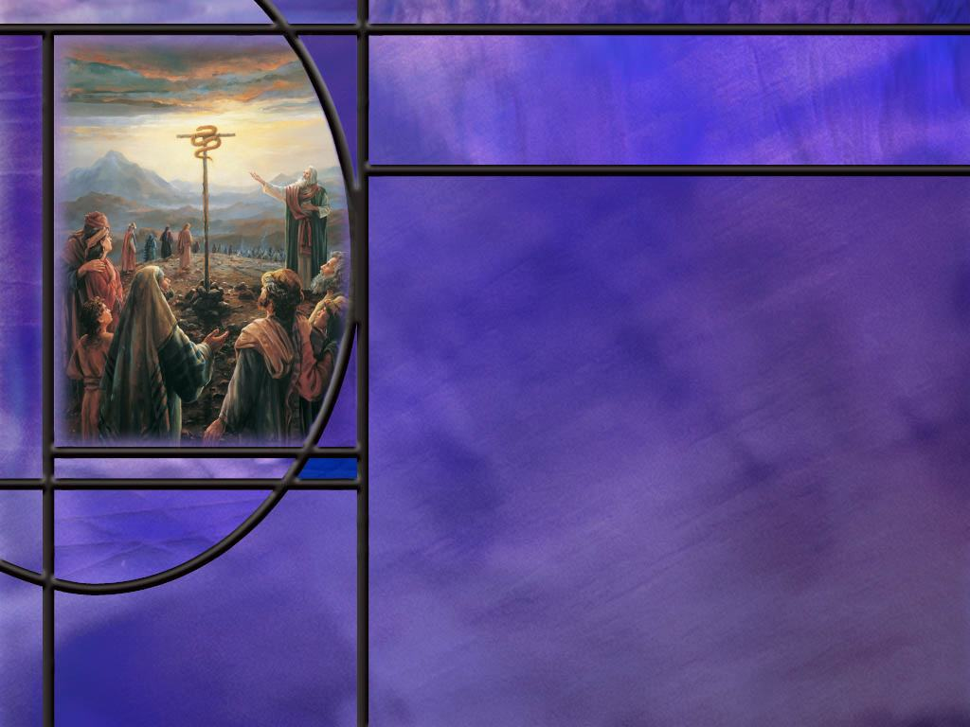
Memory Text
John 3:14-15 NKJV
"And as Moses lifted up the serpent in the wilderness, even so must the Son of Man be lifted up, ¹⁵ "that whoever believes in Him should not perish but have eternal life.
To whom is Jesus speaking these words?
What happened in the wilderness that caused Moses to lift up a pole with a serpent on it?
Why would Jesus, the Son of Man, liken Himself to a serpent on a pole?
What can Jesus offer those who look to Him in faith that Moses could not offer?
Taking verses 14 and 15 together, what is the context for believing in Jesus, the Son of Man? What must we believe about Him?
Notes:
B2:
1. This is part of Jesus’ conversation with Nicodemus.
2. You’ll remember that Nicodemus came to Jesus by night and began by complimenting Jesus on His mighty works and miracles.
3. Jesus cut to the chase and told him he needed to be born again.
John 3:3 KJV - Jesus answered and said unto him, Verily, verily, I say unto thee, Except a man be born again, he cannot see the kingdom of God.
4. And these verses in our memory text introduce to Nicodemus and to us, what we need to do to be born again.
5. It is hard to overemphasize the importance of these words that Jesus spoke to Nicodemus.
6. These words provide the introduction and the context to John 3:16, that has been describe correctly as the gospel in a nutshell.
7. This is Jesus’ clearest teaching on what the gospel is and what it does.
B3:
1. The people had murmured and complained against God and against Moses and had been disciplined for their sin by encountering fiery serpents that were killing them.
2. God instructed Moses to make a bronze serpent, put it on a pole and lift it up before the people.
Numbers 21:9 NKJV - So Moses made a bronze serpent, and put it on a pole; and so it was, if a serpent had bitten anyone, when he looked at the bronze serpent, he lived.
B4:
1. Jesus is drawing a parallel between Himself and the brass serpent that Moses raised on a pole in the wilderness.
2. Those Israelites who had been bitten by poisonous snakes were healed when they looked in faith to that raised serpent.
3. Like that brass serpent, Jesus would be raised on a cross and all who look to Him there would be healed of the snakebite of sin.
4. Why would Jesus liken Himself to a serpent, a symbol of Satan and sin?
5. Because on the cross, Jesus became sin for us.
2 Corinthians 5:21 (NKJV) For He made Him who knew no sin to be sin for us, that we might become the righteousness of God in Him.
6. So here, in a somewhat indirect way, Jesus is saying that He will die on the cross for our sin so that we can be forgiven by looking to Him in faith.
B5:
1. Jesus offers us eternal life, not just a few more years in the wilderness to eventually die a natural death.
2. While Moses brought us the law from Sinai, grace and truth came though Jesus Christ.
B6:
1. It is only those who believe in Him as their sin bearer that do not perish from the snakebite of sin but have eternal life instead.
2. So what Jesus is saying here is that it is insufficient to believe in Jesus as a great man, a wonderful example, a great prophet, a wonderful teacher, or an amazing miracle worker.
3. It is insufficient even to believe that He is the Son of God.
4. The devils believe and tremble.
5. We must believe that Jesus is our sin bearer, that he took our sins and became sin for us.
6. And when we believe that His blood cleanses us from all sin and we lay our sin upon Him through confession and repentance, He can then justify us and declare us righteous and grant us eternal life.

Slide 3
Overview
Following the conversion of Constantine and the compromise with paganism, God’s faithful remnant church that held to biblical truth was persecuted by the compromised Roman church led by the papal system. This papal power persecuted the remnant in the wilderness for 1,260 years but could not stamp out those who were faithful to the word of God.
  Rise of the Little Horn
  Persecuted Saints
  Reformation’s Morning Star
  Summary

Slide 4
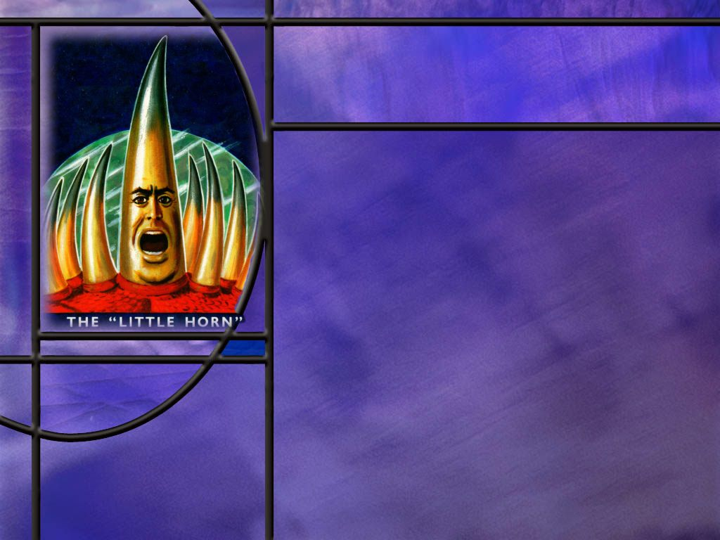
Rise of the Little Horn
What does Revelation 12 predict about God’s pure church after the ascension of Jesus? (Rev 12:1-6)
What principle can we apply to understand the time periods of apocalyptic prophecy? (Num 14:34)
What prophetic time periods become clear with this key? [Prophetic Time]
What did Daniel predict about the rise of the Little Horn? [Little Horn]
Notes:
B1:
[See notes on linked slide]
B2:
[See notes on linked slide]
B3:
[See notes on linked slide]
B4:
[See notes on linked slide]

Slide 5
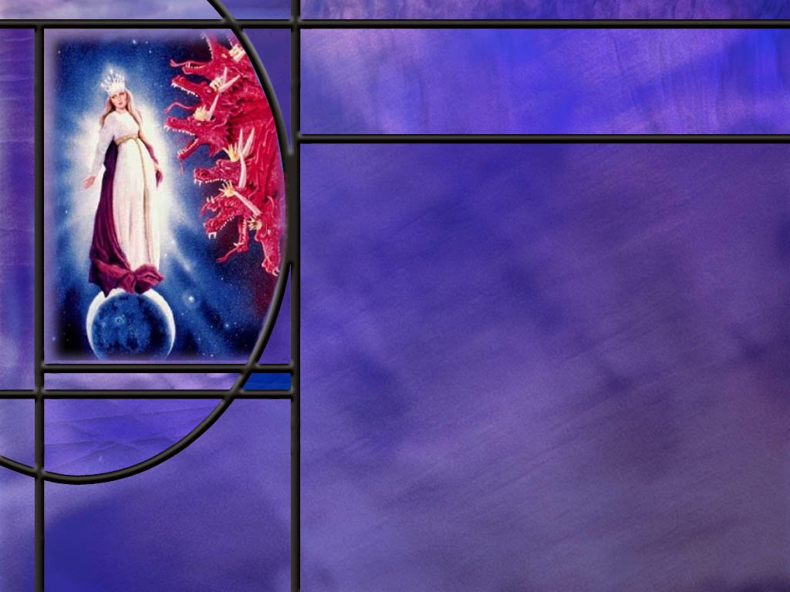
Persecuted Saints
What identifying marks of Gods true church did Jude define? (Jude 1:3)
How does John in Revelation describe what the martyrs held on to and were willing to die for? (Rev 6:9)
Who were the Waldensians and how did they contend for the faith once and for all delivered to the saints? [Waldenses - People of the Valleys | Episode 6 | Lineage (youtube.com)]
Notes:
B1:
[See notes on linked slide.]
B2:
[See notes on linked slide.]
B3:
[Play video on YouTube or download before class and play from video file.]
[Intro from Video.]
Continuing our journey through history, we explore Revelation 12:6 - the Church in the Wilderness - through the experience of the Waldensians. The Waldensians didn't see themselves as reformers needing to be separated from Rome, as they said that they never belonged to it. They have a history dating back several centuries prior, to the time of the Apostolic faith.
[Much more on the Waldensians at LineageJourney.com.]
1. In short, the Waldensians were Bible believing Christians.
2. They fit beautifully into the description of Revelation 12:6 where the woman fled into the wilderness.
3. They hand copied the Scriptures so that they could give them to those they found that were open to reading the Bible for themselves.
4. They believed in the Apostles Creed, essentially all of which we as Adventists can also agree to.
5. In the Presbyterian church in which I grew up, we stood and recited the Apostles Creed as part of every worship service.
6. They believed that justification from Christ does not require the church.
7. They rejected all the inventions of men in the affairs of religion as an unspeakable abomination before God including festival days, vigils of saints, holy-water, abstaining from flesh on certain days, and such like things, but above all, the masses.
8. They denied the existence of purgatory and said it was the invention of the antichrist.
9. They called the pope the antichrist.
10. They believed in voluntary poverty.
11. They believed there should be no additional church officers other than elders and deacons.
12. They rejected trans substantiation, the teaching that the communion symbols became the actual blood and body of Christ.
13. They believed in only two sacraments, baptism and the Lord’s Supper.
14. Unfortunately, they believed in the immortality of the soul and an eternally burning hell.
15. But as we saw in the video, there is some strong indication that they were Sabbath keepers.
16. But long before Martin Luther and the reformers of the 16th century, the Waldenses were taking a stand against the compromises and inventions of the Roman Catholic church.
17. And they suffered mightily from the iron fist of papal Rome as a result.
18. They were a fulfilment of Daniel’s description of the Little Horn that “he shall wear out the saints of the Most High.”

Slide 6
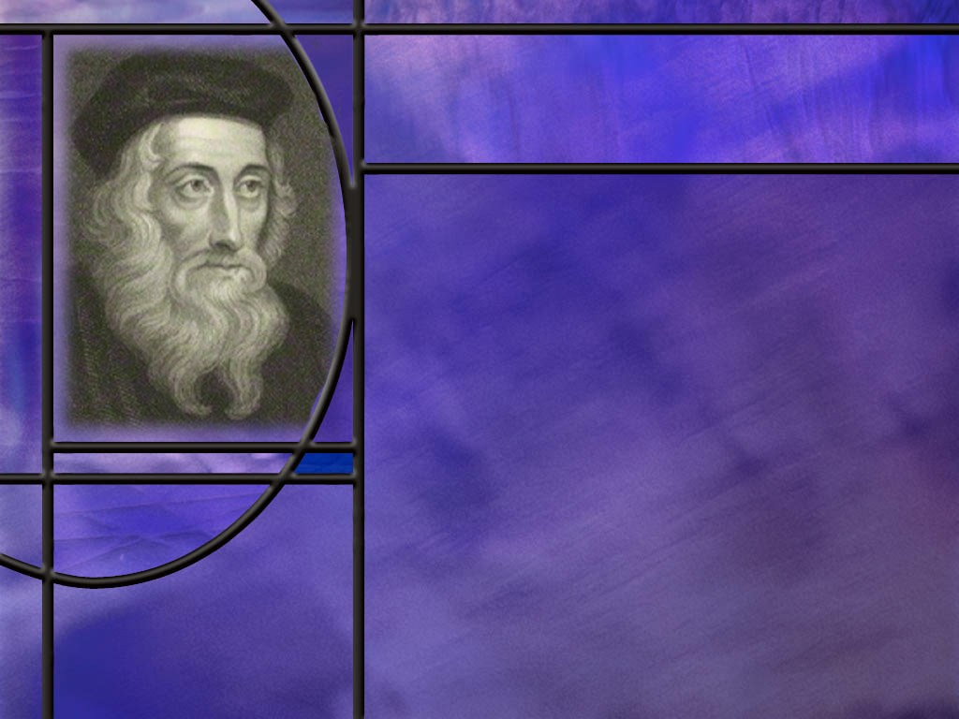
Morning Star of the Reformation
Why is John Wycliffe called the morning star of the reformation? [(1) John Wycliffe: The Morning Star | Episode 11 | Lineage – YouTube]
How did Wycliffe’s love for the word of God reflect the love of some of the authors of Scripture? (Jer 15:16; Ps 19:7-11)
What did Jesus promise the overcomers of the church of Smyrna that were suffering persecution? (Rev 2:10-11)
What promises can we claim in God’s word for eternal life, even if we suffer a premature death from persecution?
Notes:
B1:
1. The morning star is a bright star, perhaps a planet such as Venus, that can still be seen in the sky as it begins to dawn.
2. If the Reformation is the dawning of the light of truth upon the Christian world, Wycliffe is credited with shining a lesser light even before Martin Luther’s full protest against Rome.
3. Wycliffe’s greatest accomplishment for the English speaking world was to translate the Bible from Latin into English.
4. 150 years before the dawning of the Protestant Reformation, Wycliffe produced an English translation of the Bible that set the hearts of the English-speaking people on fire.
5. This prepared many to stand on the inspired word rather than the perversions of the faith promulgated by the papal system.
B2:
[See notes on linked slides.]
B3:
[See notes on linked slides.]
B4:
1. There are so many we can only scratch the surface.
2. We can start with John 3:16 and our memory text in John 3:15 that ends with basically the same words.
Romans 6:23 For the wages of sin is death, but the gift of God is eternal life through Jesus Christ our Lord.
John 11:25-26 ESV - 25 Jesus said to her, "I am the resurrection and the life. Whoever believes in me, though he die, yet shall he live, 26 and everyone who lives and believes in me shall never die. Do you believe this?"
1 John 5:11-12 ESV - 11 And this is the testimony, that God gave us eternal life, and this life is in his Son. 12 Whoever has the Son has life; whoever does not have the Son of God does not have life.
1 Timothy 6:12 ESV - 12 Fight the good fight of the faith. Take hold of the eternal life to which you were called...
1. There will be persecution in the end times.
2. Paul wrote to Timothy these words:
2 Timothy 3:12 ESV - Indeed, all who desire to live a godly life in Christ Jesus will be persecuted,
3. But although Satan is determined to do his worst, Christ will do His best.
4. Let us not be discouraged if we seem to be losing the battle; Christ has won the war.
5. Let us stand with the Waldensians and the Reformers on the inspired word of God and let the chips fall where they may.
6. We serve a Savior who has conquered death, and He is able to raise us to eternal life.
7. Paul wrote this promise to the Corinthian Christians:
2 Corinthians 4:14 ESV - knowing that he who raised the Lord Jesus will raise us also with Jesus and bring us with you into his presence.
These are great and precious promises!

Slide 7

Summary
The visions of chapters 12 – 14 constitute the Great Controversy visions that end the historical half of the book of Revelation.
In the early battle scene between the dragon and the woman, God’s true covenant-keeping people fulfill His plans, the Messiah is born, escapes Herod’s attempts to kill Him, and is caught up to God and to His throne.
The woman, representing God’s true church, flees into the wilderness, a place prepared by God to preserve her from the dragon seeking to destroy her during a time of persecution by the Little Horn power that lasts for 1,260 years, from 538 to 1798.
The day-year principle is the key that unlocks the proper understanding of the apocalyptic time prophecies of Scripture.

Slide 8
Summary
Historicist interpreters identify the Little Horn power of Daniel 7 as the papal system that combined church and state to rule from 538 to 1798.
It is through this power that the dragon, Satan, worked to persecute the saints.
Faithfulness to inspired scripture, both OT and NT, is the abiding hallmark of God’s true church through the ages and makes the end-time remnant faithful to the same doctrines as the apostolic church.
The Waldensian Christians seem to fit the description of the church in the wilderness as they fled to the mountains of northern Italy to escape the persecutions of papal Rome.

Slide 9
Summary
They trace their spiritual roots back to apostolic times, totally rejecting the compromises and inventions of the Roman Catholic church and pointing to the pope as the antichrist long before the Reformers.
For their stand on God’s word, they were severely persecuted by Rome, many giving their lives for their faith.
John Wycliffe is considered the “morning star of the Reformation” because he translated the Bible from Latin to English providing a foundation for the English speaking world to stand on Scripture rather than tradition.
Will you join today with God’s faithful church through the ages that earnestly contends for the apostolic faith once and for all delivered to the saints?

Slide 11
Revelation 12:1-6 ESV
And a great sign appeared in heaven: a woman clothed with the sun, with the moon under her feet, and on her head a crown of twelve stars. ² She was pregnant and was crying out in birth pains and the agony of giving birth. ³ And another sign appeared in heaven: behold, a great red dragon, with seven heads and ten horns, and on his heads seven diadems. ⁴ His tail swept down a third of the stars of heaven and cast them to the earth. And the dragon stood before the woman who was about to give birth, so that when she bore her child he might devour it. ⁵ She gave birth to a male child, one who is to rule all the nations with a rod of iron, but her child was caught up to God and to his throne, ⁶ and the woman fled into the wilderness, where she has a place prepared by God, in which she is to be nourished for 1,260 days. [R]
Notes:
1. Here we have a very symbolic picture of the Great Controversy at the time of the birth of Christ.
2. There is only one male child who was to rule all nations with a rod of iron, and that is Christ.
3. This goes back to Psalm 2 which is a Messianic psalm, that says that the Lord’s anointed will rule the nations with a rod of iron.
4. And in a very real sense, the dragon, Satan, tried to devour the baby Jesus as soon as He was born through Herod’s slaughter of the innocents in Bethlehem.
5. And there is only one person that the Bible says was caught up to God and to His throne and that is the resurrected Lord Jesus.
6. So here we see in symbolic language the transition from the OT to the NT dispensation.
7. Literal Israel becomes spiritual Israel as Christ establishes His church, the pure woman clothed with the sun.
8. The 12 stars on the woman’s crown can represent both the 12 tribes of Israel and the 12 apostles of the church.
9. The sun can represent the truth of the light of the gospel shining in all its glory in the NT church, while the moon, which reflects the sun can represent the types and shadows of the OT church.
Q1: What happens to the woman here after Jesus is resurrected and ascends to His Father’s throne in heaven?
1. She has to flee into the wilderness where she is nourished for 1,260 days.
Q2: How should we understand the symbolism of this text?
Who is the woman?
1. She is God’s true church, His pure church, His remnant that has not compromised with false doctrines.
2. Where is the wilderness?
3. Logically, the wilderness would be the less populated areas where the authorities and persecuting powers would not have the same influence over religious matters as in the cities.
4. The wilderness church is a secluded church that seeks religious freedom by hiding itself from the persecuting powers.
5. What does God do for the church there in the wilderness?
6. He nourishes the church and keeps it alive.
7. How long is this specific persecution go on?
8. The text says 1,260 days, but we know that in apocalyptic prophecy, one day represents one year, so this is a period of 1,260 years.

Slide 12
Numbers 14:34 NKJV
According to the number of the days in which you spied out the land, forty days, for each day you shall bear your guilt one year, namely forty years, and you shall know My rejection. [R]
Notes:
1. Here we see an example of the year-day principle.
2. For every day the spies were in the Land (40 days) the people would spend a year (40 years) in the wilderness.

Slide 13
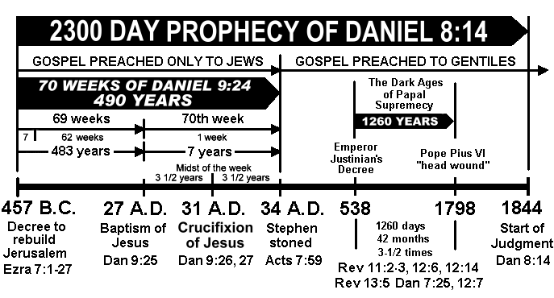
Prophetic Time in Daniel [R]
Notes:
[Go over the dates given on this slide.]
1. I would add one more date to this slide to get in all of Daniel’s time prophecies (508 AD).
2. In Daniel 12, two more time periods are listed that relate to prophetic time: 1290 days and 1335 days.
3. The 1290 days is the time from when the daily ministry of Christ was taken away and the end-time abomination of desolation was set up, presumably to when it is taken away in 1798.
4. So this is 30 years longer than the 1260 years from 538 to 1798.
5. So the 1290 years would begin in 508 AD and run to 1798 AD.
6. What happened in 508 AD?
7. This is the year that Clovis, the king of France defeated the Visigoths.
8. This was the first of the three Arian powers or horns plucked up in the rise of the Little Horn.
9. Since these Arian powers believed that Christ was a created being, in opposition to the popes position of the Trinity, this victory by Clovis was seen as an enforcement of papal authority.
10. This marked the beginning of a church state alignment with military power being used to benefit papal dogma.
11. We might say that the church-state alliance to promote papal authority began in 508 and was completed in 538.
12. The Visigoths were defeated by Clovis in 508, the Vandals by Rome in 534, and the Ostrogoths by Rome in 538.
13. Both the French and the Roman militaries were allied with the pope in these military victories.
14. The last time period that Daniel mentions is 1335 days.
15. Since this comes right after the 1,290 day period, it seems reasonable to start it at the same year, in 508.
16. Adding 1,335 to 508 brings us to the year 1843/1844.
17. This is the same time that we calculated for the end of the 2,300 day-years in Daniel 8.
18. So it brings us to the beginning of the investigative judgment and the restoration of the heavenly sanctuary.
19. Note that Daniel and Revelation mention the time of papal supremacy in 6 different passages calculated 3 different ways: 1,260 days, 42 months times 30 days per month = 1260 days, and 3.5 years times 360 days per year in the Jewish calendar = 1,260 days or 1,260 literal years.

Slide 14
Identification of the Little Horn
Arises among the 10 horns of the 4th beast
Three horns to be plucked up before it.
Has eyes like a man.
Has a mouth speaking great things against the Most High
Persecutes the saints of the Most High
Has dominion for a period of 3.5 times
Attempts to change times and laws
Destroyed by end time divine judgment. [R]
Notes:
So let’s see if the medieval Papal system fits all of these identifying marks.
1. Does it arise out of Rome as the Roman empire is breaking up? Yes!
2. Does it defeat, with the help of Clovis’ and Justinian’s military, three of the other horns? Yes! (The Visigoths, the Vandals, and the Ostrogoths).
3. Does the papal system have a man at its head? Yes! The pope!
4. Has his mouth spoken great things and pompous words against the Most High? Absolutely. Even the titles that the pope takes for himself are blasphemous. (“Vicar of Christ.” “Holy Father”)
5. Has the papal system persecuted Protestant believers? Absolutely. Millions have been tortured, put on the rack, burned at the stake, martyred for believing the word of God instead of the pope.
6. Did the papal system retain power for 3.5 times or 1260 years? Yes from 538 to 1798!
7. Has the papal system attempted to change times and laws? They openly admit to transferring the day of worship from Sabbath to Sunday. Also in their catechism they have changed the Ten Commandments, eliminating the second commandment against the worship of images and dividing the tenth commandment against coveting into two.
8. Just like the iron of Rome extended down to toes of the image, so the Little Horn continues until the divine judgment of God brings him to his end in the end times. The papal system still exists in a revived form today. So the Little Horn cannot be one man or one pope but must be the papal system.

Slide 15
Jude 1:3 ESV
Beloved, although I was very eager to write to you about our common salvation, I found it necessary to write appealing to you to contend for the faith that was once for all delivered to the saints. [R]
Notes:
Q1: For what should we as Christians contend?
1. We should contend for the faith once and for all delivered to the saints.
2. We should hold fast to and be willing to fight for the apostolic faith.
3. Jude says that, back in his day, the Christian faith had been delivered to the saints that made up the Christian church.
4. This faith is the faith of Jesus.
5. It is the body of doctrines or teachings that Christ and His apostles established.
6. It is not to be changed or compromised but to be fought for.
7. The center of the Christian faith is salvation by grace alone through faith alone in Christ alone.
8. It is righteousness by faith, being justified freely by His grace.
9. It is having our sins forgiven by laying them on Christ so that His righteousness can be laid on us.
10. It is receiving Jesus as both Savior and Lord.
11. And the faith of Jesus is defined by the inspired scripture not by the decrees of popes or church councils.

Slide 16
Revelation 6:9 KJV
And when he had opened the fifth seal, I saw under the altar the souls of them that were slain for the word of God, and for the testimony which they held: [R]
Notes:
1. In context, the 5th seal applies particularly to the martyrs of the middle ages.
Q1: For what were these martyrs slain?
1. They were slain for the word of God and the testimony that they held on to.
2. In the book of Revelation, God’s true church is described as holding onto the word of God or the commandments of God and the testimony of Jesus or the faith of Jesus.
3. This is the two witness theme of the book of Revelation, and we’ll come back to this again as we study the GC.
4. Rev 1:9 says that John was exiled to “Patmos on account of the word of God and the testimony of Jesus.”
5. Here in Rev 6:9 the martyrs of the middle ages were slain “for the word of God and the testimony [we could add: of Jesus] that they held onto.
6. In Rev 12:17, the dragon goes to make war with the remnant of the woman’s seed “who keep the commandments of God and hold to the testimony of Jesus.”
7. In Rev 14:12, those who avoid the mark of the beast: “keep the commandments of God and the faith of Jesus.”
8. The commandments of God are like the word of God, and the faith of Jesus is like the testimony of Jesus.
9. Together these describe God’s true church as those who hold fast to the Scriptures, both OT and NT.
10. The OT is the inspired word of God defining the commandments of God; the NT is the inspired testimony of Jesus defining the faith of Jesus.

Slide 17
Jeremiah 15:16 ESV
Your words were found, and I ate them, and your words became to me a joy and the delight of my heart, for I am called by your name, O LORD, God of hosts.
Notes:
Q1: What did Jeremiah do with the word of the Lord.
1. He found them and ate them.
2. That is obviously a figurative statement.
3. What do you think he is saying here?
4. He listened to them; he meditated on them; he hid them in his heart; he internalized them.
Q2: What did God’s word do for him?
1. God’s word became his joy and his delight.
2. Do we read God’s word the same way?
3. Is God’s word a joy and a delight for you?
4. Maybe we need to “eat the word” like Jeremiah.
5. When we really understand God’s plan for us and the promises He has made to us, we too should be rejoicing.
[Go to next slide.]
Q2:

Slide 18
Psalm 19:7-11 ESV
The law of the LORD is perfect, reviving the soul; the testimony of the LORD is sure, making wise the simple; 8 the precepts of the LORD are right, rejoicing the heart; the commandment of the LORD is pure, enlightening the eyes; 9 the fear of the LORD is clean, enduring forever; the rules of the LORD are true, and righteous altogether. 10 More to be desired are they than gold, even much fine gold; sweeter also than honey and drippings of the honeycomb. 11 Moreover, by them is your servant warned; in keeping them there is great reward. [R]
Notes:
Q1: Let’s review again all the adjectives David uses in this psalm to describe the law of God.
1. God’s law is perfect, it is sure, it is right, it is pure, it is clean, it is totally true and righteous.
Q2: And what is God’s law able to do for us:
1. It revives our soul, it makes us wise, it rejoices our hearts, it enlightens our eyes, it endures forever.
2. It warns us from evil and brings great reward in obedience.
3. No wonder David describes God’s law as being more precious than gold and sweeter than honey.

Slide 19
Revelation 2:10-11 ESV
Do not fear what you are about to suffer. Behold, the devil is about to throw some of you into prison, that you may be tested, and for ten days you will have tribulation. Be faithful unto death, and I will give you the crown of life. ¹¹ He who has an ear, let him hear what the Spirit says to the churches. The one who conquers will not be hurt by the second death.' [R]
Notes:
Q1: What is Jesus’ promise to those who are persecuted or even martyred for their faith and fidelity to the word of God?
1. Be faithful unto death and I will give you the crown of life.
2. You may suffer the first death but I will deliver you from the second death.
3. Our lives are in the hands of God, and no one can separate us from the love of God.

