Slide 1
The Great Controversy
Lesson 5
Faith Against All Odds

Slide 2

Memory Text
Psalm 119:11 NKJV
Your word I have hidden in my heart, That I might not sin against You.
What does this verse have to do with the Great Controversy?
What does God’s word tell us about Satan?
How does memorizing Scripture help us to be obedient to the will of God?
How did Jesus defeat Satan in the wilderness of temptation?
Notes:
B2:
1. Here on earth, the GC has become a battle for our minds and hearts.
2. Both Christ and Satan are vying for our allegiance.
3. And where do we find out the truth about these two opposing combatants?
4. We find that truth in the word of God.
5. Jesus wants us to know the word, believe the word, memorize the word, and live according to the word.
6. Satan wants us to ignore the word, and live as we please.
B3:
1. The Bible describes Satan as a fallen angel, a deceiver of our first parents, a liar and the father of lies, a murderer from the beginning, the accuser, the adversary, the tempter, the enemy of God and of Christ; he promotes false doctrines and seeks to keep unbelievers in spiritual bondage.
2. Satan wants you to ignore the word of God and the truth it presents about him and his plans to lead you to the lake of fire.
3. So this text is important in our approach to the GC because the Bible is our source of truth about spiritual realities.
4. It tells us of the goodness of God and the evil of Satan.
5. It tells us about God’s ultimate victory and Satan’s ultimate defeat.
6. And it tells us how we can be redeemed by the blood of Jesus and end up on the winning side in the Kingdom of God.
B4:
1. The word of God expresses the will of God.
2. Memorizing key portions of the word helps us to remember it and apply it.
3. We can’t do the will of God unless we know the will of God.
4. And when we memorize the Word we can know it, recall it, meditate on it, and apply it.
B5:
1. To every temptation, Jesus had a response: “It is written.”
2. Did Jesus need to pull out the scroll of Deuteronomy and look it up in order to quote the verse?
3. No. He had God’s word hidden in His heart.
4. That’s where we need to hide it too: in our hearts and in our minds.
5. I don’t think there’s any easy way to memorize scripture.
6. Some find putting it to music is helpful.
7. It may be just taking a book of the Bible and underling the key verses you want to memorize and keep going over them until they sticks.
8. It’s hard work, but memorization should be an important part of our study of the word.
Supplemental Questions:
Q1: What do we memorize and remember?
1. Its not the hard things that we don’t understand.
2. It’s the simple things, the meaningful things, the precious truths and promises, it’s the gospel and its power to change lives, it’s texts like John 3:16.
3. The important truths of the Bible are embarrassingly simple.
4. Even a child can understand: Jesus loves me this I know; for the Bible tells me so.
Q2: How many think they could name off the 10 commandments in order?
1. If you can, you’re way ahead of the general public.
2. In a recent survey, only 14% of those asked could name all 10 commandments.
3. Less than 60% knew that “Thou shalt not kill” was one of the 10 commandments.
4. Try it on one of your non-Christian friends.
5. Ask them to name the 10 commandments and see how many they come up with.
Sin is the transgression of the law, and we can’t avoid sin unless we know what the Law says.
So let’s hide God’s word in our hearts and choose obedience over rebellion.

Slide 3
Overview
During the 1,260 years of papal supremacy and persecution, the compromised church was successful in suppressing the truth of God’s word and promoting their own inventions in place of the apostolic faith. The Protestant Reformation began as courageous men of God rediscovered the Bible and made it central to the reformation faith.
  Reformation Solas
  Back to the Bible
  More Reformers
  Summary

Slide 4
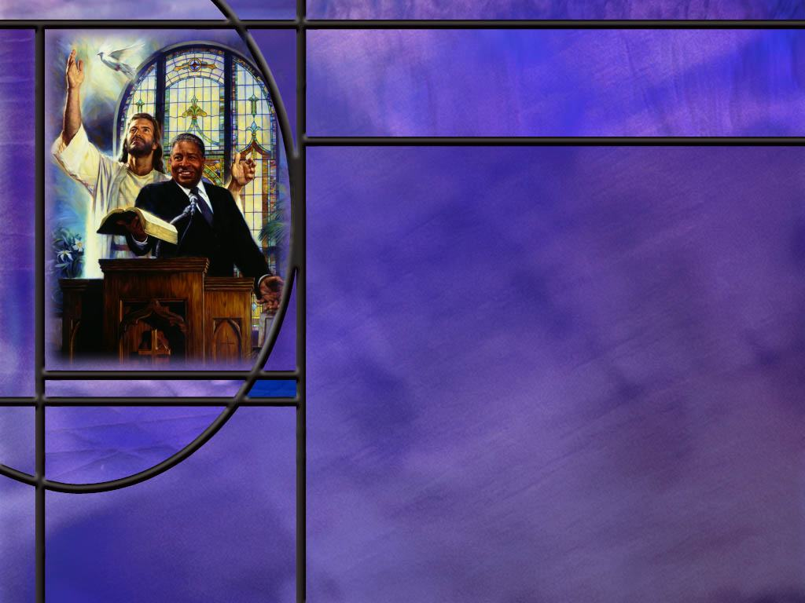
Reformation Solas
What cryptic description does Revelation give of the persecution of God’s true church in the middle ages? (Rev 12:14-15)
What are the five “Solas” of the Protestant Reformation? [Solas]
Given Paul’s inspired words that “all scripture is ‘God breathed,’” what should we anticipate about its unity?
Why is it important for the Bible to present a unified picture of the subjects it treats?
How should we try to resolve apparent contradictions in the Bible?
Notes:
B1:
[See notes on linked slide]
B2:
[See notes on linked slide]
B3:
1. If it is all inspired by God than it should all be unified by God’s view of creation, history, morality, sin, forgiveness, salvation, the future, truth, and every other subject upon which the Bible speaks.
2. Who is the ultimate author of Scripture?
3. Remember Peter wrote:
2 Peter 1:21 (NKJV)
²¹ for prophecy never came by the will of man, but holy men of God spoke as they were moved by the Holy Spirit.
4. The HS is not going to inspire one man to say one thing and another to say the opposite.
5. Unity of Scripture is one of several factors we can point to that proves the Bible is God’s word.
6. Although it was written by some 40 different men with widely different backgrounds over a period of 1500 years and coming from different cultures and geographical locations, and speaks on scores of controversial subjects, it presents one truth and tells one story, the story of redemption.
B4:
1. Truth is not a matter of opinion or personal preference.
2. Those who believe in God believe that there is absolute truth.
3. We want to know what is true according to God’s view of things.
4. Remember Jesus’ prayer:
John 17:17 (NKJV)
¹⁷ Sanctify them by Your truth. Your word is truth.
5. If the Bible is just men’s opinions that contradict each other, it is useless.
6. It would tell us someone’s opinion of truth, which might really be error instead of truth.
7. To believe the Bible as God’s infallible truth, it must be unified on the subjects it treats.
8. God is not the author of confusion, but of peace.
9. And we can have peace that the Bible is God’s word because the HS has inspired its unity.
Incidentally, other proofs we can point to are the Bible’s confirmation by archaeology, it’s careful transmission and wealth of manuscripts, its fulfilled prophecy, and its ability to change lives.
B5:
1. Study the contradictory texts using Bible study tools that can help understand the meaning.
2. Read the texts in their context.
3. Read the texts in various modern translations.
4. See if there have been any manuscript changes, and use the oldest and best manuscripts.
5. Consult commentaries to see how others have resolved the apparent conflict.
6. Without a doubt, you are not the first person to observe an apparent contradiction.
7. Check out how other people have resolved it.
8. If you cannot resolve the apparent conflict, be confident that there is an explanation, and don’t let it shake your faith in the truth of scripture.

Slide 5
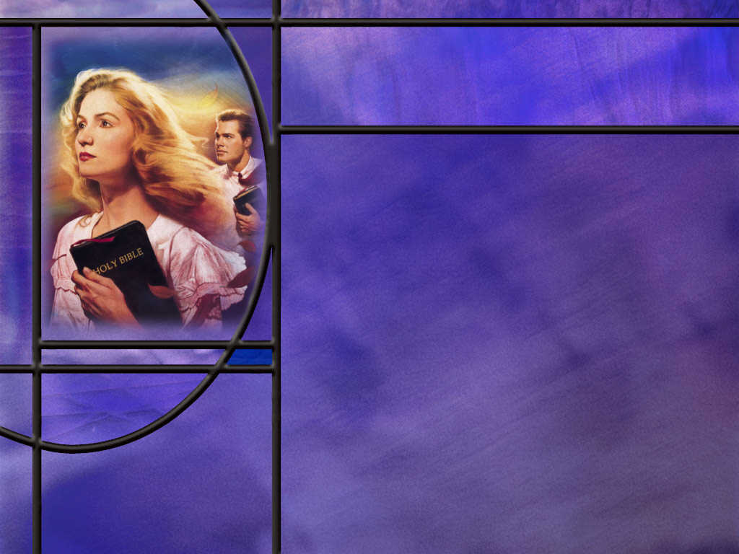
Back to the Bible
How did Paul’s definition of the Gospel rest on the witness of Scripture? (1 Cor 15:1-4)
How did Paul describe his handling of the word of God? (2 Cor 4:2)
What did the Bereans do to discern whether or not Paul’s preaching was correct? (Acts 17:11)
How does the Bible say we can discover its truth? (John 16:13a)
In contrast, where do Roman Catholics get their “truth?”
Notes:
B1:
[See notes on linked slide.]
B2:
[See notes on linked slide.]
B3:
[See notes on linked slide.]
B4:
[See notes on linked slide.]
B5:
1. They have what they call the teaching magisterium of the church.
2. Wikipedia gives this definition:
The magisterium of the Catholic Church is the church's authority or office to give authentic interpretation of the word of God, "whether in its written form or in the form of Tradition".^{[1][2][3]} According to the 1992 Catechism of the Catholic Church, the task of interpretation is vested uniquely in the Pope and the bishops.
3. In other words, the clergy of the Catholic church headed by the pope decide what is true and what is the proper interpretation of scripture and tradition.
4. And the claim of the church is that the pope is infallible in his decrees of catholic doctrine.
5. This makes it impossible for the church to correct anything that is false since the doctrine of infallibility means that nothing can possibly be false!

Slide 6
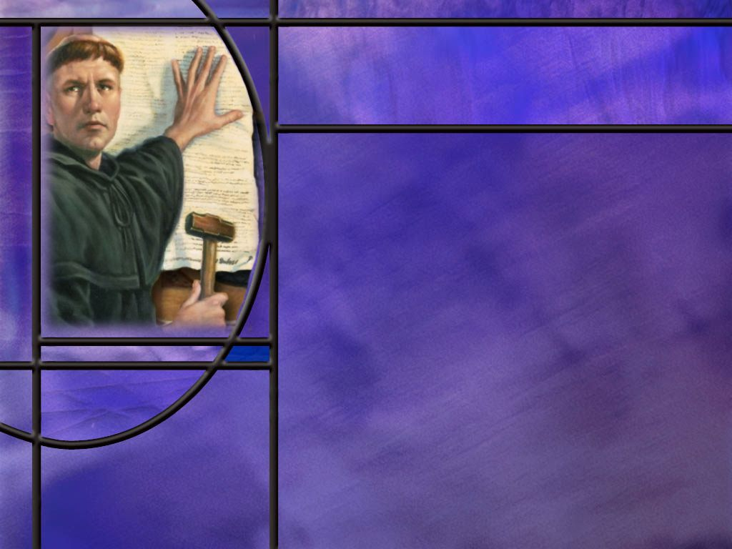
More Reformers
For what do we remember William Tyndale?
What act of Martin Luther sparked the Protestant Reformation?
(3) Martin Luther: 95 Theses | Episode 21 | Lineage – YouTube
What perversion of the gospel moved Martin Luther to nail his 95 theses to the door of the Wittenberg church?
How successful was Luther in restoring the true gospel to Roman Catholicism?
What was the main area of disagreement between the Reformers and the Council of Trent?
Notes:
B1:
1. Tyndale translated the Bible from the original languages into English.
2. His translation was an improvement over Wycliffe’s translation from 140 years previously which used the Latin Vulgate as its source.
3. Tyndale was condemned as a heretic for his efforts and strangled and burned at the stake in 1536.
4. However, within four years of his death, four English translations of the Bible were published.
5. In 1611 when King James authorized the translation of the Bible to English, known as the King James Version (KJV), it relied heavily on Tyndale’s translation.
B2:
Most historians would cite the nailing of the 95 theses to the door of the church in Wittenberg on October 31, 1517.
That is the subject of a short video we have on Martin Luther.
B3:
[Play video if time permits. About 5 min]
B4:
1. It was the sale of indulgences by the Roman Catholic church to raise money for the repair of St. Peter’s Basilica in Rome.
2. Johann Tetzel was the friar in charge of selling indulgences in Germany.
3. I don’t know his jingle in German, but the English translation goes like this: "As soon as the coin in the coffer rings, the soul from purgatory springs"?
4. Is this a perversion of the gospel? (Absolutely.)
5. Martin Luther did the right thing in opposing “another gospel.”
6. There is only one true gospel: it is the gospel Paul preached and that Luther rediscovered.
B5:
1. Unfortunately, the RC church opposed Luther rather than submitting to the gospel Paul preached.
2. There were many within the RC church that saw the need for reform, but a new Catholic order called The Society of Jesus or the Jesuits strongly opposed it and led the Catholic counter-reformation.
3. The Jesuits were founded in 1534 by the Spanish noble Ignatius Loyola and was formally recognized by the pope in 1540.
4. The Jesuits were a totalitarian institution demanding complete obedience to an infallible church and an infallible pope.
5. Their constitution demanded the rejection of all opposing opinion or judgment including their own.
6. The Jesuits spearheaded the catholic counter-reformation at the Council of Trent in northern Italy.
7. The Jesuits persuaded the Council of Trent to grant no doctrinal reforms to the Protestants.
8. Roman Catholics and Protestants are still separated today by the doctrinal differences of the Reformers and the Council of Trent.
B6:
1. The fundamental issue of the Reformation was the doctrine of justification by faith.
2. The issue was, How can a sinner be just (or righteous) before God?
3. The Reformers and the Council of Trent came up with two different answers.
4. The Catholic view, formulated by the Council of Trent and influenced by the Jesuits, was based largely on church tradition.
5. The view of the Reformers was based on scripture.
6. On January 8, 1562 at the opening of the final period of the council, the archbishop of Reggio declared that church tradition had authority over Scripture.
7. Among other things, he cited the change of the day of worship from the seventh day to the first.
8. As Adventists, we must admit that Luther was inconsistent in claiming scripture only as his guide while abandoning Sabbath for Sunday.
9. That’s why the Reformation began with Luther but still continues today as we seek to get back to biblical Christianity.
10. But we see a difference in the approach to truth between Trent and the Reformers: Trent put tradition above scripture, the Reformers based their view on scripture only.
13. This difference in approach led to differences in doctrinal understanding on a number of subjects:
The meaning of justification,
The basis of justification,
The means of justification, and
The effect of justification.
14. It also led to a different understanding of the nature of sin and human depravity.
15. Our perception of truth must be based on the inspired word of God.
16. Jesus said in prayer to His Father:
John 17:17 (NKJV)
¹⁷ Sanctify them by Your truth. Your word is truth.
17. Why would anyone base their view of the gospel on the fallible opinions of men rather than the infallible word of God?
18. The church is not infallible; the pope is not infallible; the Jesuits are not infallible, only God and His word are.

Slide 7

Summary
During the 1,260 years of papal supremacy and persecution, the papal system was successful in suppressing the truth of God’s word and promoting their own inventions in place of the apostolic faith.
The Protestant Reformation began as courageous men of God rediscovered the Bible and made it central to the reformation faith.
William Tyndale translated the Bible from the original languages into English, and was martyred for his efforts.
Martin Luther rediscovered the biblical truth that “the just shall live by faith,” and he focused his preaching and teaching on righteousness by faith.

Slide 8
Summary
Beginning with Luther, the Reformers developed five “solas:” scripture alone, grace alone, faith alone, Christ alone, and glory to God alone.
Out of these came the Reformer’s formula for justification: We are justified by grace alone (God’s part) through faith alone (our part) in Christ alone, nothing else being necessary.
The reformer’s position of Scripture alone was opposed by papal Rome who put tradition above Scripture and came to a much different understanding of justification.
This difference in understanding the gospel of salvation still separates Protestants and Roman Catholics today.

Slide 9
Summary
As Protestants, Adventists remain on the cutting edge of the Reformation seeking to take it all the way back to the apostolic faith.
We accept the Reformation solas and seek to make the Bible our only rule of faith and practice.
We take as our end-time commission the task of calling people out of the spiritual confusion of Babylon and into the remnant that are faithful to God’s word.
To be effective in our efforts, we need the Holy Spirit to empower us to understand the Scriptures and share them effectively.
Will you stand with the Reformers this week confident that the word of God is a full and sufficient guide to spiritual truth?

Slide 11
Revelation 12:14-15 ESV
But the woman was given the two wings of the great eagle so that she might fly from the serpent into the wilderness, to the place where she is to be nourished for a time, and times, and half a time. ¹⁵ The serpent poured water like a river out of his mouth after the woman, to sweep her away with a flood. [R]
Notes:
Q1: How long is the woman in the wilderness in this verse?
1. For a time, times, and half a time: 3.5 years.
2. But we know that three and a half years is the same as 1,260 days since the Jewish year had 360 days per year.
3. So this is the same 1,260 days that we see in verse 6 of chapter 12 and at various other places in Daneil and Revelation.
4. This is the period that the Little Horn of Dan 7 and 8 would wear out the saints of the Most High: from 538 to 1798.
5. Verse 6 says:
Revelation 12:6 ESV - and the woman fled into the wilderness, where she has a place prepared by God, in which she is to be nourished for 1,260 days.
6. So the time period is the same (1,260 years), the place is the same (the wilderness), and the purpose is the same (to be nourished or preserved by God).
7. This is not a new wilderness experience but is a continuation and expansion of the same wilderness experience introduced in verse 6.
8. The wilderness experience in these verses may refer back to the way God nourished the Israelites in their wandering in the wilderness with manna from heaven and water from the rock.
Q2: How does the devil try to destroy this woman in the wilderness?
1. He attempts to carry her away with a river of water from his mouth.
Q3: What came out of the serpent’s mouth in the garden of Eden?
1. Lies and deception that deceived the first woman and brought a curse upon God’s creation.
2. Now he again attacks another woman representing God’s true followers.
3. Ranko Stefanovic in is commentary on the book of Revelation says this about the river:
“The flood-like river proceeding from the mouth of the serpent portrays in symbolic language Satan’s two strategies – persecuting force and deception and false teachings – for harming God’s people during the symbolic three-and-a-half years of the church’s wilderness pilgrimage.”
4. We can also surmise that the waters represent peoples and multitudes and nations and tongues (Rev 17:15)
5. So here we see the majority persecuting the minority.
6. The papal church had the masses on its side and the force of the state to give them the power of a raging river to sweep away their opposition.
7. But God protected the woman by calling men of courage to stand up and oppose the papal church by championing the word of God as the only valid authority in spiritual matters.
8. We will consider some of those men in our lesson today.

Slide 12
The Five Solas of the Reformation
Sola Scriptura, or “God’s Word alone,” maintains that the Bible and the Bible only is our rule of faith and practice.
Sola gratia, or “grace alone,” says sinners are saved as an unearned gift of God’s grace, “not as a result of works, so that no one may boast” (Eph 2:8–9).
Sola fide, or “faith alone,” affirms that justification—being made right with God—comes only through faith in Jesus.
Solo Christus, or “Christ alone,” emphasizes the exclusivity of Jesus’ role in salvation: “No one comes to the Father except through me” (John 14:6).
And soli Deo gloria, or “to the glory of God alone,” says that the purpose of creation, salvation, and everything—including our goal as Christians—is the glory of God, “that God may be all in all” (1 Cor 15:28). [R]
Notes:
1. “Sola” is Latin for alone. When someone sings a solo, he sings alone.
[The Latin for grace, gratia, is pronounced grah’.sha]
2. The Reformation formula for salvation was: “We are saved by grace alone through faith alone in Christ alone, nothing else being necessary.”
3. And we can add that: this formula is based on Scripture alone and all are saved to the glory of God alone.
Q1: Of these five solas, why should sola scriptura be listed first?
1. All of the others solas follow from taking scripture alone as our rule of faith and practice.
2. How do we know that salvation or justification comes by grace alone (God’s part) through faith alone (our part)?
3. It is because we take scripture alone as our guide to truth.
4. And that is exactly what Eph 2:8-9 says
Ephesians 2:8-9 ESV - For by grace you have been saved through faith. And this is not your own doing; it is the gift of God, ⁹ not a result of works, so that no one may boast.
5. You don’t need the sacraments of the RC Church; you don’t need to purchase indulgences so that the excess righteousness of the saints can be applied to your account; you don’t need to do the prescribed penance that the priest requires for forgiveness.
6. All you need to do is accept by faith the grace of God offered us in Christ alone.
7. And the grace that God offers us is justification by trusting in the shed blood of Jesus for the forgiveness of our sins.

Slide 13
1 Corinthians 15:1-4 (NKJV)
Moreover, brethren, I declare to you the gospel which I preached to you, which also you received and in which you stand, ² by which also you are saved, if you hold fast that word which I preached to you—unless you believed in vain. ³ For I delivered to you first of all that which I also received: that Christ died for our sins according to the Scriptures, ⁴ and that He was buried, and that He rose again the third day according to the Scriptures, [R]
Notes:
Q1: In the definition of the Gospel of salvation, where do you see the authority of Scripture?
1. This is the closest that Paul comes to a definition of the Gospel of salvation.
2. In essence he says, Christ died for our sins, he was buried, and he rose again the third day.
3. And in two places he includes the phrase “according to the Scriptures.”
4. So here is Paul’s gospel of salvation by grace through faith, and he bases it squarely upon the Scriptures.
5. Paul could go back to the OT and prove to his Jewish hearers that Jesus was the Messiah.
Q2: On the road to Emmaus, how did Jesus prove to Cleopas and his friend that the Messiah must suffer and die before entering into His glory?
Luke 24:27 ESV - And beginning with Moses and all the Prophets, he interpreted to them in all the Scriptures the things concerning himself.
1. The OT Scriptures are filled with messianic prophecies, with types and symbols that Christ fulfilled as recorded in the NT.
2. For Jesus, the Scriptures were God’s inspired word.
3. In fact, He castigated the Pharisees and religious leaders for the traditions they used to nullify the word of God.
Mark 7:9, 13 NIV - 9 And he continued, "You have a fine way of setting aside the commands of God in order to observe your own traditions! ... 13 Thus you nullify the word of God by your tradition that you have handed down. And you do many things like that."
4. And, of course, we know of all the traditions and restrictions they placed on the Sabbath and its observance until they made it burden rather than a joy.
5. Here we see the danger of adding tradition to the word of God and giving it equal or greater weight.
6. It was a problem with the Jews in Jesus’ day and it was an even greater problem in the compromised Christian church.

Slide 14
2 Corinthians 4:2 NLT
We reject all shameful deeds and underhanded methods. We don't try to trick anyone or distort the word of God. We tell the truth before God, and all who are honest know this. [R]
Notes:
Q1: How did Paul describe his handling of the word of God?
1. His ways as a minister of Christ are diametrically opposed to Satan’s
2. He doesn’t try to trick anyone or deceive them or distort the word of God.
3. He simply tells the truth as it comes from God’s inspired word.
4. On the other hand, Satan does use shameful deeds and underhanded methods to try to blind us to the truth and keep us in spiritual darkness.
5. He is only too eager to use liberal theologians to distort the word of God and rob it of its inspiration, its fulfilled prophecies, and its miracles.

Slide 15
Acts 17:11 (NKJV)
¹¹ These [the Bereans] were more fair-minded than those in Thessalonica, in that they received the word with all readiness, and searched the Scriptures daily to find out whether these things were so. [R]
Notes:
Q1: How did the Bereans respond to Paul’s preaching about Christ?
1. There are two things the Bereans did: they received the word with “great eagerness” [NASB], and they tested what they heard by the Scriptures.
2. They were not afraid of new light. They were not afraid to hear something new.
Q2: How can we become more like the Bereans?
1. Don’t be afraid to listen to something new.
2. But make sure we test everything by the word of God before we make up our minds to follow it.
3. I don’t want to become like the JW’s. They won’t read any literature, not even the Bible, unless it’s produced by the Watch Tower organization.
4. Truth is progressive. Let’s not get stagnated in the truth as it was understood by the pioneers of the Advent faith.
5. Let’s be willing to consider new ideas even if they don’t come from the ABC.
6. But we must be sure to test all things by the Scriptures: the 66 books of the Bible.
7. Don’t believe something because “that’s what my church believes.”
8. Believe it because you can find it in the Word of God.
9. “If it’s not in the word it doesn’t deserve to be heard, but if it’s in the book, let’s take a look.”
[Illustration]
I heard a story about a new pastor who was trying to get a feel for the beliefs of one of his elders.
So the pastor asked him, “What do you believe?’
The elder responded, “I believe what my church believes?”
So the Pastor asked, “Well then, what does your church believe?”
To which the elder replied, “My church believes what I believe.”
Thinking he would try one more time for specifics, he asked, “Ok then, what do you and your church believe?”
To which the elder replied, “My church and I believe the same thing.”
10. There may be some who think there is merit in believing only what their church believes.
11. But no church has authority over the word of God.
12. We would be on safer ground to say I believe the Word of God, OT and NT, the Law and the Testimony.
13. The early Adventists were fond of saying “We have no creed but the Bible.”

Slide 16
John 16:13a ESV
When the Spirit of truth comes, he will guide you into all the truth, [R]
Notes:
Q1: How should we discover truth according to this text?
1. We should seek the guidance of the Holy Spirit as we read Scripture.
2. Jesus said,
John 17:17 ESV - Sanctify them in the truth; your word is truth.
3. If the HS inspired the word of God then He can guide us into a proper understanding of its truth.
4. The HS may well work in a way in which truth is revealed progressively.
5. It may take years to get in line with all God’s truth.
6. But we are responsible for the truth that the Spirit has reveled to us.
7. And as we accept and follow, God opens to our hearts more truth.
Q2: What is the source of truth for the Roman Catholic church?
1. They have what is called the teaching magisterium of the church.
2. Wikipedia gives this definition:
The magisterium of the Catholic Church is the church's authority or office to give authentic interpretation of the word of God, "whether in its written form or in the form of Tradition".^{[1][2][3]} According to the 1992 Catechism of the Catholic Church, the task of interpretation is vested uniquely in the Pope and the bishops.
3. In other words, the clergy of the Catholic church headed by the pope decide what is true and what is the proper interpretation of scripture and tradition.
4. And the claim of the church is that the pope is infallible in his decrees of catholic doctrine.
5. This makes it impossible for the church to correct anything that is false since the doctrine of infallibility means that nothing can possibly be false!

