Slide 1
Psalms
Lesson 4
The Lord Hears and Delivers

Slide 2
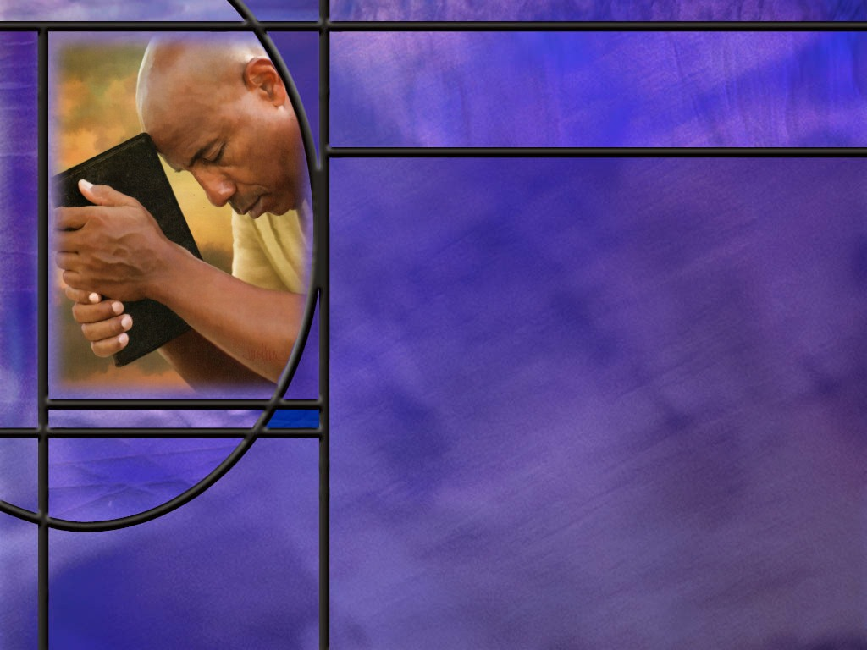
Memory Text
Psalm 34:17 NKJV
The righteous cry out, and the LORD hears, And delivers them out of all their troubles.
To whom is the promise of this verse made?
Who are the righteous?
What is necessary for the Lord to hear and deliver?
How can we rationalize this promise with the fact that the grim reaper eventually comes for all of us?
Notes:
B2:
1. It is made to the righteous.
2. But you will notice that in this verse, “the Righteous” are in italics.
3. That means that these words are not in the original Hebrew or Greek but have been supplied by the translators to convey what they think the meaning is.
4. Most English translations supply the same words here: “the righteous.”
5. The Christian Standard Bible has a footnote after righteous that says the literal translation is “They cry out…”
6. So we have to look back at the context to see who “they” are.
7. If we look at verses 15 and 16, it is clear that David is drawing a contrast here between the righteous and the wicked.
8. So let’s back up two verses and read what David says with a little more context:
Psalm 34:15-17 ESV - The eyes of the LORD are toward the righteous and his ears toward their cry. ¹⁶ The face of the LORD is against those who do evil, to cut off the memory of them from the earth. (Then we come to our memory text in verse 17.) ¹⁷ When the righteous cry for help, the LORD hears and delivers them out of all their troubles.
9. So even though “the righteous” is not in the original, it makes sense based on the context that David is referring to the cry of the righteous in this verse.
10. This idea is repeated in verse 19 which says:
Psalm 34:19 ESV - Many are the afflictions of the righteous, but the LORD delivers him out of them all.
B3:
1. In this psalm, the righteous are those who do what is right as opposed to those who do evil.
2. In verse 11 David describes them as those who fear the Lord.
3. In verses 13 and 14, he describes them with these words:
Psalm 34:13-14 ESV - 13 Keep your tongue from evil and your lips from speaking deceit. 14 Turn away from evil and do good; seek peace and pursue it.
4. So the righteous are those who fear the Lord, who bow in reverence and respect before Him, who acknowledge Him as their God and keep His commandments.
5. David is describing a practical righteousness that results from a loving, submissive relationship with God.
6. The apostle Paul describes practical righteousness in Rom 8:4
Romans 8:4 ESV - in order that the righteous requirement of the law might be fulfilled in us, who walk not according to the flesh but according to the Spirit.
7. For us to be walking in the Spirit, we need to be filled with the Holy Spirit.
8. And that only happens when we trust Jesus as a living Person for the forgiveness of our sins and are justified by faith in Him.
9. All those God justifies, He sanctifies and fills with the HS.
10. So born-again believers would qualify as “the righteous” in David’s terminology.
B4:
1. The righteous need to “cry out.”
2. And how do we cry out to God?
3. We pray sincerely; we cast ourselves upon the Lord; we plead His love and grace and mercy; we plead for His intervention; we fast to show our focus and sincerity.
4. The implication is that if we don’t cry out in prayer, the Lord will not hear and deliver.
5. Prayer changes things.
6. What a friend we have in Jesus (Hymn 499, 2nd verse)
Have we trials and temptations,
Is there trouble anywhere,
We should never be discouraged,
Take it to the Lord in prayer.
Can we find a friend so faithful,
Who will all our sorrows share,
Jesus knows our every weakness,
Take it to the Lord in prayer.
B5:
1. The ultimate fulfillment of this promise is the resurrection and eternal life in the kingdom of God.
2. Jesus said:
John 16:33 KJV - … In the world ye shall have tribulation: but be of good cheer; I have overcome the world.
3. The way we ultimately overcome the world and its troubles is to be “in Christ.”
4. To be ‘in Christ” means to be justified by faith in Him.
5. We are justified when we are trusting in Jesus as our living Lord and Savior and have all our sins laid on Him and His righteousness laid on us.
6. When we are “in Christ,” we can look forward to ultimate deliverance.
7. We can say, with David, as he ends the 23rd psalm: “And I will dwell in the house of the Lord forever.”

Slide 3
Overview
The psalmists are clear about the God of whom they sing. He is not just the Creator and supreme ruler of the universe, He is the immanent God that comes close to His people, He knows them, He hears their cries of distress, and He delivers them.
  The Immanent God
  The God that Helps
  God Our Refuge
  Summary

Slide 4
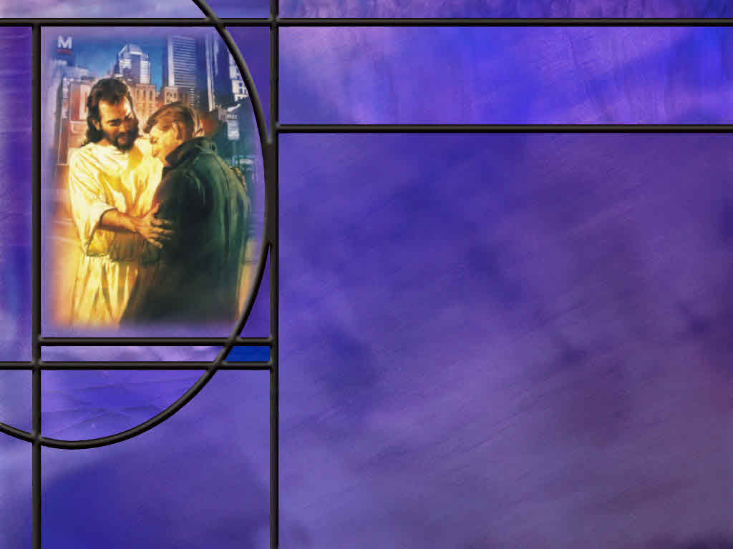
The Immanent God
What does it mean that God is immanent?
How does David describe the immanence of God in His knowledge of us? (Ps 139:2-6)
How does David describe the omnipresence of God in the world He created? (Ps 139:7-10)
How does David marvel at the creative genius of God demonstrated by living beings? (Ps 139:13-16)
Notes:
B1:
1. Immanence is a theological word used to describe a certain aspect of God.
2. Last week we described God as Creator, Owner, and King.
3. And these titles help us to understand the transcendence of God.
4. To say that God is transcendent is to say that He is above, outside, beyond, independent of His creation.
5. God existed before He created the universe and He will exist after it is gone.
6. He transcends the normal limits of existence.
7. Immanence is the flip side of transcendence.
8. To be immanent means that God can be experienced and known.
9. It means that God is not somewhere out there, but here with us.
10. As Paul said in his address to the Greek philosophers:
Acts 17:27-28 ESV - 27 that [men] should seek God, and perhaps feel their way toward him and find him. Yet he is actually not far from each one of us, 28 for "'In him we live and move and have our being'; as even some of your own poets have said.
11. So, the famous theological question is: “Do you believe in the transcendent God or the immanent God?”
12. And the correct answer is we don’t have to choose. He is both.
B2:
[See notes on linked slide.]
B3:
[See notes on linked slide.]
B4:
[See notes on linked slide.]

Slide 5
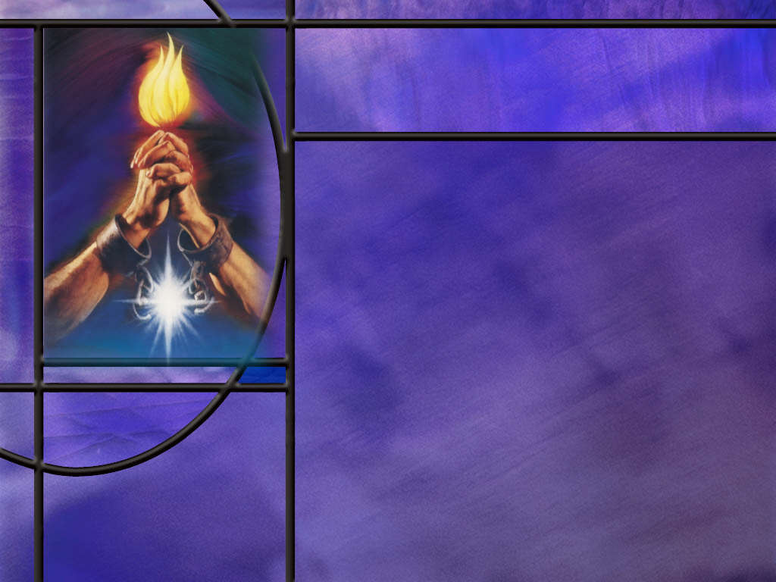
The God that Helps
How does the psalmist portray God’s power and presence for pilgrims marching to Zion? (Ps 121:1-4)
What function does the Lord perform for those who are willing to be guided by God? (Ps 121:5-8)
Notes:
B1:
[See notes on linked slide.]
B2:
[See notes on linked slide.]

Slide 6
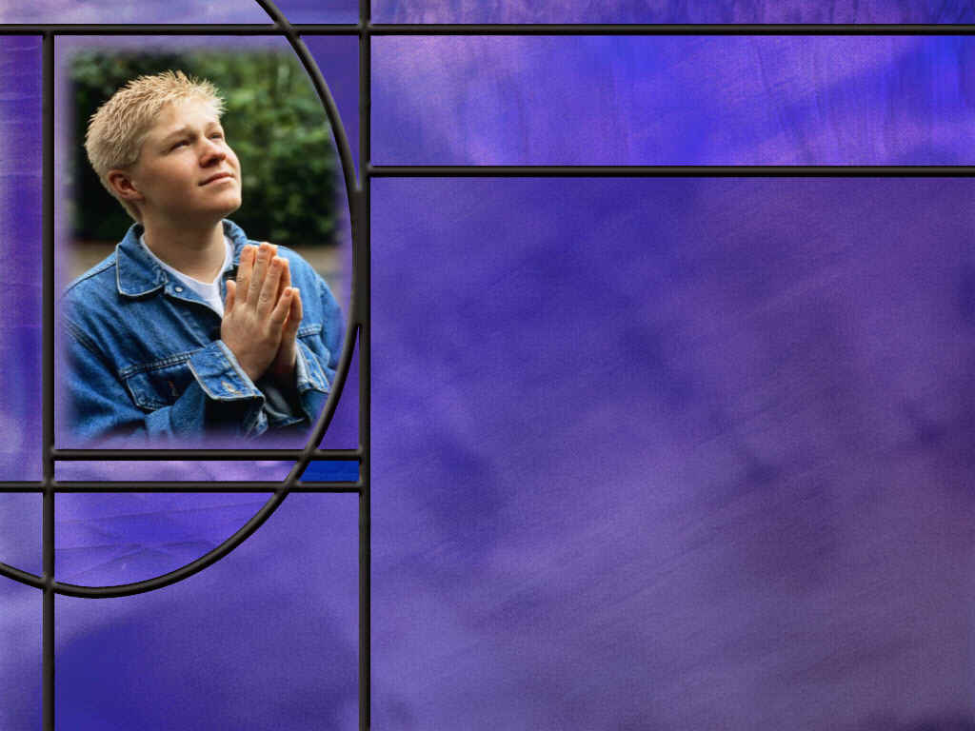
God Our Refuge
How does the psalmist describe the relationship that leads to God’s protection? (Ps 91:1-2)
What promises does the Lord make at the end of this psalm? (Ps 91:14-16)
Between the opening and closing of this psalm, what examples does the psalmist give of how God can be a refuge for those who trust in Him? (Ps 91:3-13)
Notes:
B1:
[See notes on linked slide.]
B2:
[See notes on linked slide.]
B3:
[See notes on linked slide.]

Slide 7

Summary
In our lesson last week we looked at how the psalmists described the transcendent God who is independent of His creation and rules as Creator, King, Law Giver, and Judge
This week we look at the flip side as the psalmists describe the immanent God who is not far from every one of us and who hears and delivers those that love Him.
In Psalm 139 David describes God’s intimate knowledge of him. God knows when he stands up and sits down; He knows the words he is about to speak before he utters them.
David goes on to describe the omnipresence of God: there is no place he can go where God is not present.

Slide 8
Summary
Finally David describes the genius of God seen in the reproductive process.
Modern science confirms that the information contained in DNA cannot arise by chance. Human DNA has an information content equivalent to over 100 volumes of the encyclopedia Britannica.
God’s intimate knowledge of us, His omnipresence in our physical world, and His careful crafting of our procreative process all speak of the immanence of God.
Psalm 121 assures us that God is available 24/7/365 to help us and keep us. He will watch over our journey in life, not just for time, but forevermore.

Slide 9
Summary
Our help comes from the omnipotent God who made heaven and earth.
Psalm 91 describes the deliverance available to those who dwell in a close relationship with the Lord.
The psalm ends with great and precious promises to those who love the Lord, who know His name, and who call upon Him in prayer.
While God may not always deliver the righteous immediately, He will deliver us ultimately.
Will you claim the promises of these wonderful psalms this week, confident that God is able to deliver, but if not, confident of His ultimate deliverance at the resurrection when He returns?

Slide 11
Psalm 139:2-4, 6 ESV
You know when I sit down and when I rise up; you discern my thoughts from afar. 3 You search out my path and my lying down and are acquainted with all my ways. 4 Even before a word is on my tongue, behold, O LORD, you know it altogether. ... 6 Such knowledge is too wonderful for me; it is high; I cannot attain it. [R]
Notes:
Q1: How does David describe the omniscience of God in His knowledge of the creatures He created?
1. God knows everything about him.
2. Even the simplest things like when he stands up and sits down.
3. God reads his mind; He knows his thoughts.
4. Before he speaks a word, God knows what it is going to be.
5. So God has an intimate knowledge of each one of us.
6. He is the immanent God as well as the transcendent God.

Slide 12
Psalm 139:7-10 ESV
Where shall I go from your Spirit? Or where shall I flee from your presence? ⁸ If I ascend to heaven, you are there! If I make my bed in Sheol, you are there! ⁹ If I take the wings of the morning and dwell in the uttermost parts of the sea, ¹⁰ even there your hand shall lead me, and your right hand shall hold me. [R]
Notes:
Q1: What do these verses say about God’s presence throughout His creation?
1. God is everywhere present.
2. He is omnipresent.
3. There is no where that we can go to escape the presence of God.
4. That’s why Jonah was so foolish in thinking he could flee from the presence of the Lord.
5. The Holy Spirit is not limited to physical places.
6. He can be everywhere at once.
7. He dwells in the hearts of Christian believers all around the world.
8. And He can intercede for each of us when we turn to God in prayer.
Q2: What does David mean when he writes, “If I make my bed in Sheol, your are there!”
1. Sheol is simply the grave where the dead are buried.
2. Here it may be used in contrast to the heights of the heavens.
3. The NIV translates it this way:
Psalm 139:8 NIV - If I go up to the heavens, you are there; if I make my bed in the depths, you are there.
4. So the depths may represent the deepest ocean valleys.
5. No matter how high or how low, God is still there.
6. How about outer space? Is He still there?
7. Yes. Outer space is still part of the heavens.

Slide 13
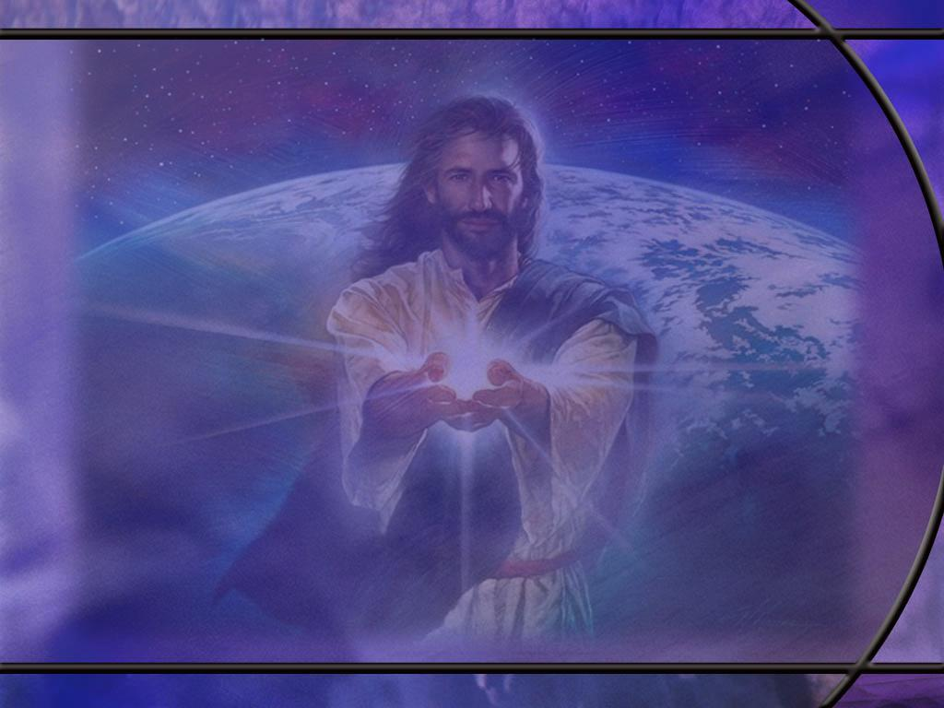
Psalm 139:13-16 ESV
For you formed my inward parts; you knitted me together in my mother's womb. ¹⁴ I praise you, for I am fearfully and wonderfully made. Wonderful are your works; my soul knows it very well. ¹⁵ My frame was not hidden from you, when I was being made in secret, intricately woven in the depths of the earth. ¹⁶ Your eyes saw my unformed substance; in your book were written, every one of them, the days that were formed for me, when as yet there was none of them. [R]
Notes:
Q1: For what is David praising God in this passage?
1. He is praising Him for the procreation process that the Lord has devised and incorporated into His creation.
2. The more we understand about the process of procreation the more amazing it becomes.
3. He understands that it was God’s handiwork that allowed him to be knit together in this mother’s womb.
4. In verse 15 he refers to being made in secret, “intricately woven in the depths of the earth.”
5. “The depths of the earth” is figurative poetic language to emphasize the secrecy of the growing process from conception to birth.
6. The NLT translates is as:
Psalm 139:15 NLT - You watched me as I was being formed in utter seclusion, as I was woven together in the dark of the womb.
Q2: How amazing is the reproductive process that produces a new human life from the genetic material of a mother and father?
1. The birth of my first child had a dramatic impact on my evolutionary world view.
2. Reproduction of living things is one of the strongest evidences we have of God’s design in creation.
3. Half of the DNA to form a new life comes from the father and half comes from the mother.
4. The likeness of one or both parents can be seen in their offspring, so every new life is unique.
5. And the process that controls the development from fertilized egg to newborn baby just seems miraculous.
6. How do the cells being added in growth know what kind of cells to become?
7. But brain cells are added to the brain; eye cells are added to the eye; heart cells are added to the heart; it is all controlled by the process that our genius God devised and put into place for every living thing.
8. Everything has its unique DNA structure which controls every characteristic of the child that is born: its sex, its eye color, its hair color, its skin color, its features.
9. In fact by reading the genetic code, God could know what we look like before we looked that way.
10. The double helix structure of human DNA holds about 3.5 billion base pairs, and these base pairs are all in a meaningful sequence.
11. In living things, these base pairs are copied to produce proteins and enzymes that are used to repair cells and catalyze biochemical reactions.
12. A strand of human DNA contains about 875 megabytes of information, which is equivalent to about 106 volumes of the encyclopedia Britannica. (Does our DNA really have as much information as an encyclopedia set? - The Tech Interactive)
13. That is a lot of information!
14. Information requires an intelligent source; it does not arise by time and chance.
15. So human DNA and the reproductive process provide strong evidenced of creation by an intelligent God, who not only created the DNA but put it together with all the other biochemicals required for its translation in a cell and gave it life.

Slide 14
Psalm 121:1-4 ESV
(A Song of Ascents). I lift up my eyes to the hills. From where does my help come? ² My help comes from the LORD, who made heaven and earth. ³ He will not let your foot be moved; he who keeps you will not slumber. ⁴ Behold, he who keeps Israel will neither slumber nor sleep. [R]
Notes:
Q1: What is a song of ascent?
1. A song of ascent was a psalm meant to be sung by pilgrims climbing Mt. Zion, the hill on which Jerusalem was built.
2. All men of age were required to attend three annual feasts: Passover, Pentecost, and Tabernacles.
3. There are 15 songs of ascent that were sung either climbing to Jerusalem or at the temple in Jerusalem.
4. They are Psalms 120 – 134.
5. Ps 121 was most likely sung at the beginning of the ascent.
6. We can visualize the pilgrims lifting up their eyes to view the hills upon which the city and their temple are built.
Q2: What is the psalmist’s answer to the rhetorical question about the source of his help?
1. His help comes from the omnipotent God who made heaven and earth.
2. Again, as last week, we have all caps for LORD indicating God’s proper name YHWH.
3. The only evidence we need of the power of our God is the creation that He made.
4. Our sun uses nuclear fusion at its core to produce a tremendous amount of energy by converting mass to energy.
5. It has been estimated that the energy from our sun is sufficient to melt a bridge made of ice that is 2 miles wide, 1 mile thick and extends from the earth to the sun (93,000,000 miles) in just 1 second!
6. Multiply that by at least 100 billion galaxies each containing at least 100 billion stars, many of which are much larger and more powerful than our sun.
7. The heavens indeed declare the glory of God and the firmament sheweth His handiwork.
8. We have the privilege of calling on the name of the omnipotent God.
Q3: What assurance does this psalm give us that our God is available 24/7/365.
1. Our God never needs to take a nap or call a lid on His office hours.
2. He never goes on vacation.
3. We may think of Elijah on Mt. Carmel, mocking the prophets of Baal to call louder because maybe Baal is sleeping.
4. Our God is always ready to hear and to help when we cry out to Him.

Slide 15
Psalm 121:5-8 ESV
The LORD is your keeper; the LORD is your shade on your right hand. ⁶ The sun shall not strike you by day, nor the moon by night. ⁷ The LORD will keep you from all evil; he will keep your life. ⁸ The LORD will keep your going out and your coming in from this time forth and forevermore. [R]
Notes:
Q1: What does the Lord do for those who fear Him?
1. He becomes their keeper, the one who watches over them and preserves them.
2. God is like a shade that protects us from fiery trials of life.
3. We can always go to Him to reduce the heat of battle and bring us peace.
4. The Lord will keep us from evil and preserve our life.
5. This is reminiscent of the Lord’s prayer: “Lead us not into temptation but deliver us from evil.”
6. When we surrender to His guidance, He will watch over our journey in life, not just for time, but forevermore.

Slide 16
Psalm 91:1-2 ESV
He who dwells in the shelter of the Most High will abide in the shadow of the Almighty. ² I will say to the LORD, "My refuge and my fortress, my God, in whom I trust.“ [R]
Notes:
Q1: What relationship leads to the protection of the LORD?
1. What picture does the first verse give you in this psalm?
2. When we dwell somewhere, that’s where we live.
3. When we abide somewhere, that’s were we stay.
4. We’re not occasional visitors there, but that’s where we hang out.
5. So these are kind of parallel phrases that mean the same thing.
6. When we dwell in the shelter of the Most High and abide in the shadow of the Almighty, we are living and walking close to the Lord.
7. This speaks of a loving relationship in which we stay close to the Lord.
Q2: How does verse 2 add to this picture of a close walk with the Lord?
1. It confesses that Yahweh is my God; it confesses that I trust in Him; it confesses that He is my protector, my refuge and fortress.

Slide 17
Psalm 91:14-16 ESV
"Because he holds fast to me in love, I will deliver him; I will protect him, because he knows my name. ¹⁵ When he calls to me, I will answer him; I will be with him in trouble; I will rescue him and honor him. ¹⁶ With long life I will satisfy him and show him my salvation." [R]
Notes:
Q1: What conditions need to be fulfilled for us to claim these promises?
1. We find three conditions here:
2. First: “he holds fast to me in love.”
3. God’s promises are for those who love Him.
4. And what will we do if we hold fast to Him in love?
John 14:15 ESV - 15 "If you love me, you will keep my commandments.
5. The second characteristic is “he knows my name.”
6. What does it mean to know the name of the Lord?
7. It means to know His character.
8. Not just to know it intellectually but to know it experientially.
9. We think of the 144,000 that have the father’s name written on their foreheads.
10. They seek to emulate the character of God.
11. And the greatest relational attribute of the character of God is love.
12. So those who know His name will seek to live in love.
13. As Paul writes in 1 Cor 16:14
1 Corinthians 16:14 ESV - 14 Let all that you do be done in love.
14. The third characteristic is that “he calls on me.”
15. We need to be people of prayer.
16. Jesus said:
Matthew 7:7-8 KJV - Ask, and it shall be given you; seek, and ye shall find; knock, and it shall be opened unto you: 8 For every one that asketh receiveth; and he that seeketh findeth; and to him that knocketh it shall be opened.
17. The implication is that if we don’t ask, we won’t receive.
18. So let’s be people of prayer.
Q2: What are the promises of these verses?
1. The promises are:
2. I will deliver him; I will protect him; I will answer him; I will be with him in trouble; I will rescue him and honor him; I will satisfy him with long life; and I will save him.
3. Does that sound like a good deal to you?
4. Praise the Lord!
5. Let’s remember what Paul wrote to the Corinthians:
2 Corinthians 1:20 ESV - 20 For all the promises of God find their Yes in him [Jesus Christ].
6. In His perfect life, Jesus fulfilled all of the covenant obligations, and it is through Him that we receive all the covenant blessings.
7. We can be truly righteous by having our sins forgiven and having Christ’s righteousness imputed to us.
8. Then we can circle back to our memory text and read it again:
Psalm 34:17 ESV - When the righteous cry for help, the LORD hears and delivers them out of all their troubles.
9. Let me spin it a little bit from the temporal to the eternal.
10. When we are righteous in Christ, and when we confess our sins, the Lord hears and delivers us from all of our sins.
11. And the result is: we will dwell in the kingdom of God forever.

Slide 18
Psalm 91:3-13 ESV
Deliverance from:
the snare of the fowler
the deadly pestilence
the terror of night,
the arrow that flies by day,
the pestilence that stalks in darkness,
the destruction that wastes at noonday.
You will receive:
no evil
no plague
angels to guard you in all your ways.
protection from the lion and the adder. [R]
Notes:
Q1: Who would not want this kind of protection from the Lord God Almighty?
1. This psalm has been a blessing to many who have passed through difficult times.
2. It give us hope that God is able to deliver us from even the most difficult circumstances.
Q2: But how do we deal with those times when God allows us to go through difficulties and trials?
1. God does not always deliver us immediately, but He always delivers us ultimately.
2. Remember what Peter wrote to the church:
1 Peter 4:12-13 ESV - Beloved, do not be surprised at the fiery trial when it comes upon you to test you, as though something strange were happening to you. ¹³ But rejoice insofar as you share Christ's sufferings, that you may also rejoice and be glad when his glory is revealed.
3. Peter’s point is that we can rejoice in suffering for Christ, knowing we shall share His glory when He returns to save us.
4. And remember the words of James in:
James 1:2-4 ESV - Count it all joy, my brothers, when you meet trials of various kinds, ³ for you know that the testing of your faith produces steadfastness. ⁴ And let steadfastness have its full effect, that you may be perfect and complete, lacking in nothing.
5. James’ point is that we can rejoice in trials because they strengthen our faith and make us mature Christians ready to meet even bigger trials.
6. If God does not deliver us, be assured that He goes with us through the fiery trials we endure.
7. Remember that God the Father endured the agony of the cross, refusing to deliver His only Son so that we might be saved.
8. In the same way, the God that loves us endures the agony of our suffering, allowing us to endure no more than we can bear with His help.

